Slide 1
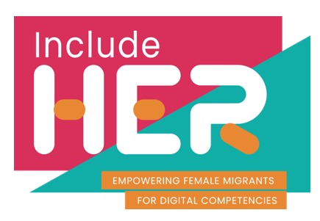


Welcome to
Module 4
Digital Safety
Part of our
INCLUDE HER Digital Development Resources
This programme has been funded with support from the European Commission. The author is solely responsible for this publication (communication) and the Commission accepts no responsibility for any use that may be made of the information contained therein 2020-1-DE01-KA203-005668

Slide 2

“
Digitalisation in education can really support a lot of disadvantaged groups in society, not just refugees, and we're working with the Government now to expand the program.
SOPHIA, BERLIN
“
https://www.digitalcityofrefuge.com/people/berlin/migration-matters

Slide 3
Overview
Protecting personal data and privacy
Module 4 will provide learning on how to protect your personal data and privacy in digital environments, as well as health and wellbeing. These topics are important competencies in higher education environment, especially for female migrant students to tackle any digital gaps on their education path.
It will tackle a range of issues from technical knowledge about protecting one’s safety online, to information on how to use technology so that our physical and mental health is kept safe, and in the process, we protect our environment.
1
Protecting health and wellbeing
2
Protecting devices
3
Protecting the environment
4

Slide 4
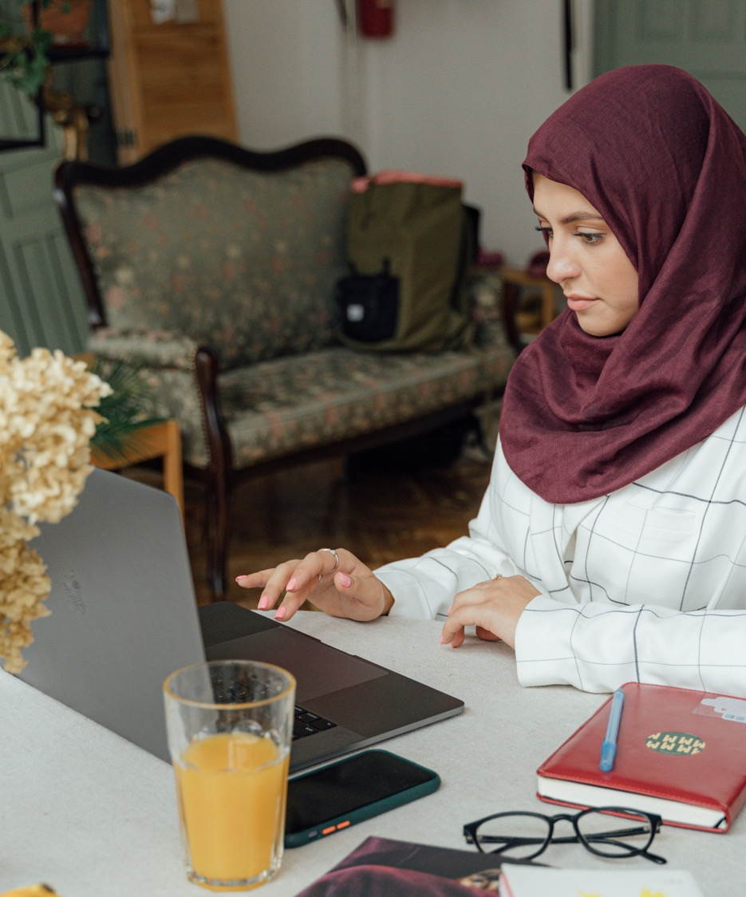
1. Protecting personal data and privacy

Slide 5
Important definitions
Data privacy generally means the ability of a person to determine for themselves when, how, and to what personal information about them is shared with or communicated to others.
Data Security includes a set of standards and different safeguards and measures taken in order to prevent any third party from unauthorized access to digital data, or any intentional or unintentional alteration, deletion or disclosure of data.

Slide 6
Why is Data Privacy important?
Data Privacy or Information privacy encompasses 3 elements:
Right of an individual to be left alone and have control over their personal data
Procedures for proper handling, processing, collecting, and sharing of personal data
Compliance with data protection laws
DATA SECURITY
DATA PRIVACY
PROTECTED USABLE DATA

Slide 7
In 2019, 73% of customers said trust in companies matters more than it did a year ago and we can safely assume that the numbers have gone up.¹
Be aware, as a student or citizen, everything you are doing online or tools you are using, are property of some company.
REMEMBER - In the digital world, even when you are not buying, you are always someone’s customer, using tools created by some company to navigate the internet and technology
That is why organizations need to learn how to process personal data while protecting the privacy preferences of individuals. This is what individuals expect from organizations.
SOURCE: https://www.salesforce.com/au/blog/2019/06/state-of-the-connected-customer--engagement-trends-you-need-to-k

Slide 8

“
According to Gartner’s predictions for the future of privacy, by 2023, 65% of the world’s population will have its personal information covered under modern privacy regulations, up from 10% today
“

Slide 9
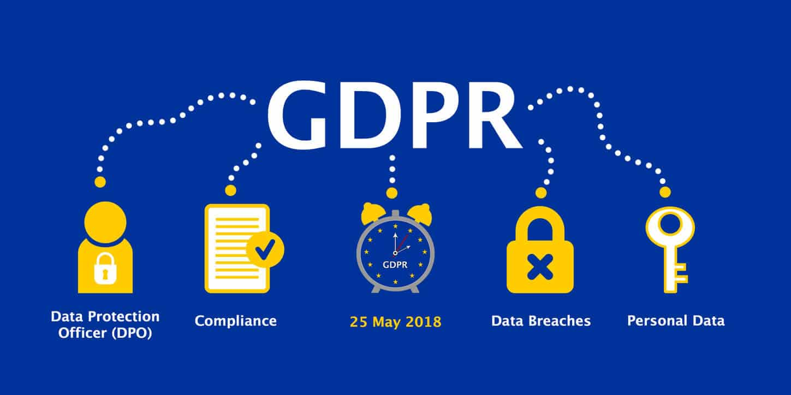

Heard about GDPR?
The GDPR is an important component of EU privacy law and of human rights law. It also addresses the transfer of personal data outside the EU and EEA areas.
Although the GDPR was not the first privacy law, it was the most comprehensive and groundbreaking data protection law that reflected the new digital era in the way data is created and managed in modern everyday business processes.
READ MORE ABOUT GDPR: https://gdpr-info.eu/

Slide 10

Learn more about Digital Privacy and security
WATCH HERE
Or watch directly on YouTube: https://www.youtube.com/watch?v=3YIPQrEWOeY&feature=emb_logo
It’s easy to spot how our world is changed in terms of technology – take a look around your home. We live in digital reality. Our lives are becoming dematerialised – summarised in digital data

Slide 11


Using and sharing personally identifiable information
Personally Identifiable Information (PII) consists of information that, on its own or combined with a limited amount of other data, can be used to identify a person. Some types of information are considered more sensitive than others.
There are two types of PIIs:
Sensitive Personally Identifiable Information
Non-Sensitive Personally Identifiable Information
SOURCE https://usercentrics.com/knowledge-hub/personally-identifiable-information-vs-personal-data/

Slide 12
Sensitive Personally Identifiable Information
Some examples of linked/sensitive PII:
  first and last name
  home address
  email address
  telephone number
  passport number
  driver’s license number
  Social Security Number
  photo of a face
  credit card number
  account username
  fingerprints
  financial records
  medical records
Information that is directly tied to a person’s identity, like first and last name or credit card number, is sensitive Personally Identifiable Information, or linked data. This is because this information is directly or almost directly linked to, and can reveal, an individual’s identity.

Slide 13
Non-Sensitive Personally Identifiable Information
Some examples of linkable or
non-sensitive PII:
  first or last name (if it’s common)
  mother’s maiden name
  partial address, like a country or zip code
  age range, e.g. 35-44
  date of birth
  gender
  employer
This kind of information is also referred to as linkable data, because it requires more data elements to be linked together to establish an individual’s identity. Whereas sensitive PII can reveal identity on its own or with very limited combined information sources.

Slide 14

Understanding privacy policy statements
Websites and apps are increasingly prompting you to read and acknowledge their privacy policies, a statement that indicates how a company will handle your data.
A good privacy policy will thoroughly explain the types of information collected, how that information is gathered, and whether it will be shared with third parties. A privacy policy should also indicate how or if your information will be tracked.
To minimize information tracking, consider opting out of ad trackers and proactively managing your cookies by deleting them, as well as your history and cache.
https://www.allstateidentityprotection.com/content-hub/beginners-guide-understanding-privacy-settings

Slide 15
What a good privacy policy will include? (1/2)
Before you share information with a website, it is important to understand how the company will handle your data. Since privacy policies are dense by nature, it is helpful to know what should be included.
A good privacy policy will:
Describe the types of information that’s collected, such as payment methods and IP addresses, and outline how they’re used
Describe the types of information that’s collected, such as payment methods and IP addresses, and outline how they’re used
Disclose how information is gathered, including the use of browser cookies
Identify any third parties or organizations that might have access to your information

Slide 16
What a good privacy policy will include? (2/2)
Outline the available privacy choices, with instructions on how to opt out of information sharing — and the consequences of doing so
Outline compliance with the Children’s Online Privacy Protection Act (COPPA) if the site collects data from children under 13
Describe the types of information that’s collected, such as payment methods and IP addresses, and outline how they’re used
Provide contact information for further inquiries
Describe the site’s security protocols
If you’re having trouble understanding a privacy policy, search for it on pribot.org. This site was created by researchers looking to simplify privacy documents for the average consumer.

Slide 17
Watch for these keywords
SIGNIFICANT KEYWORDS
Share
Control
Delete
Choice
Third Parties
Turn off
It is critical to make informed decisions about the data you share. So, when you’re skimming a marathon-length policy, be mindful of words and phrases that can signal important disclosures.
If you see the words “third parties,” for example, check if your data is being sold to advertisers or if there’s a more legitimate reason for passing your information along, such as streamlining the checkout process with help from a trustworthy payments app.
https://www.allstateidentityprotection.com/content-hub/beginners-guide-understanding-privacy-settings

Slide 18
Remembering digital footprint lesson (from Module 2)
Cookies
Tracked
Share
By looking over the privacy policy for each new site you visit, you can better understand how your data is tracked and what choices you have about the information you share.
But since that level of attention is not always possible, you can get ahead of some privacy issues by proactively managing your interaction with cookies.
As you surf the web, sites can leave “cookies” on your system. Think of them as virtual breadcrumbs. Cookies gather information and track your browsing behaviour, creating a trail of where you’ve been online.

Slide 19
Remembering digital footprint lesson (Module 2)
Digital footprint
Limit
Profits
Sometimes cookies come in handy. They may help a site remember your log-in information or record your preferences for a future visit. But companies can also use them to capture your data, which can translate to big profits for them — at your expense.
The good news is you can set controls to limit what you share and minimize your digital footprint. Then, even if you don’t have time to read a site’s privacy policy, you’ll still be partially covered.

Slide 20
Top Tips to Manage your Digital Footprint
Look yourself up online
List down all your accounts
Use privacy settings
Keep things professional
Keep your profile up to date
Don’t overshare
Delete unflattering content
Check your browser for cookies
Protect your passwords
Use strong passwords
Create a second email account
Share your achievements
Think before you post
Always update your software
SOURCE: How To Manage Your Digital Footprint: 20 Tips for Students, by Imed Bouchrika, Chief Data Scientist & Head of Content

Slide 21
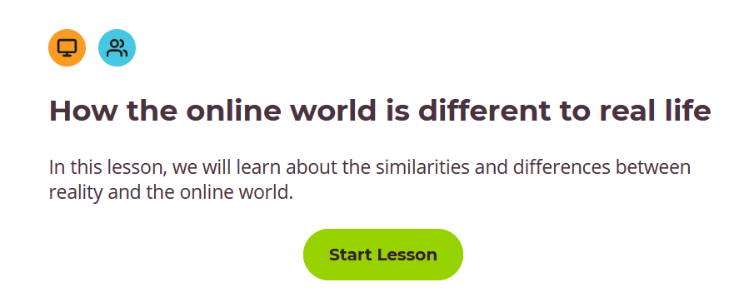


Activity:
The Quiz
Do a self-assessment
Ctrl + Click
To start Lesson

Slide 22

2. Protecting health and wellbeing

Slide 23
Important definitions
Digital wellbeing is a term used by health professionals, researchers and device manufacturers to describe the concept that when humans interact with technology, the experience should support mental and/or physical health in a measurable way.
Technostress is a stress caused by an inability to cope with modern technology.

Slide 24
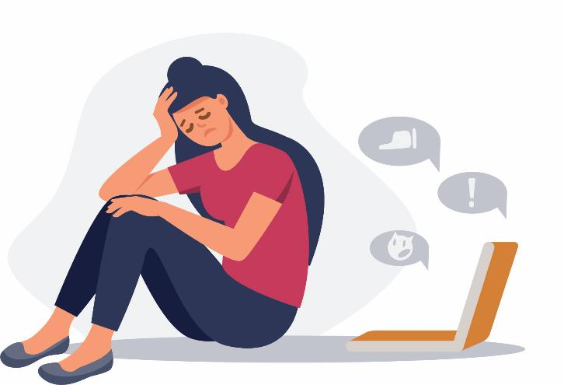
Supporting students to develop healthy digital habits
Digital technologies are now integral to daily life, and the world’s population has never been more interconnected. Innovation, particularly in the digital sphere, is happening at an unprecedented scale (enhanced by COVID impacts).
Overuse of digital technologies can lead to problems with emotional wellness, like anxiety and depression.
https://www.tribalgroup.com/blog/digital-wellbeing-supporting-students-to-develop-healthy-digital-habits

Slide 25
Supporting students to develop healthy digital habits
Higher education, online learning and remote student services have become synonymous since the outbreak of Covid-19 in early 2020.
The world of online learning and virtual environments and the intellectual stimulation it provides can help students feel more connected to others, more productive and more engaged.
However, learning and delivering services online can also make students feel disconnected and fatigued, as well as increase their concerns about staying motivated and absorbing the material. This can lead to anxiety and low mood.
It is partly because screens keep us from other activities that are good for our wellbeings such as experiencing nature, daily exercise and social support.
https://www.tribalgroup.com/blog/digital-wellbeing-supporting-students-to-develop-healthy-digital-habits

Slide 26

“
Without physically going into university or meeting people face-to-face, I’ve found that I’m spending most of my days in the same space, just moving from screen to screen. This is making me feel tired, isolated and demotivated and over time it’s starting to really impact on my mood.
“
M.Priestley, a PhD student at Durham University

Slide 27

Digital wellbeing considerations
When optimizing digital health, multiple health-related components can be taken into consideration. This can include fo example:
Limiting screen time to a certain number of minutes or hours over the course of a day or week.
Reducing eye strain infrequent device users. Products such as dark panels that cover screens or special lenses that go over glasses to reduce glare have been developed to aid with eye strain.

Slide 28
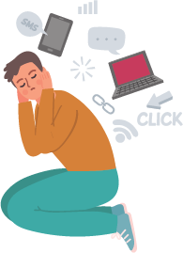
Digital wellbeing considerations
Being aware of unforeseen mental health impacts. One example of an adverse feature to mental health is the endless scroll addition to social media platforms like Facebook and Instagram. This has been attributed to internet addiction.
Increasing emphasis on physical activity and nutrition. Many technological devices have been developed to help devices users bring up fitness levels, track heart rate, report daily step count and monitor diet.
Supporting healthy sleep patterns, especially for users that
bring devices with them to bed. Users can set their devices
to turn off certain features at bedtime or change the screen
contrast or switch to grayscale to reduce eye strain.
https://whatis.techtarget.com/definition/digital-wellbeing

Slide 29
Examples of digital wellbeing tools
Various tools have been created to increase digital wellbeing, such as:
Website blockers that allow users to block certain websites, either at all times or during certain time intervals, to decrease distraction and increase productivity.
Usage dashboards, like the one integrated into the Android OS, that track how many hours a user spends on different apps or websites.
App timers limit how many minutes or hours a user can spend on certain websites or applications per day.
Google Shush is a feature that switches a device to "do not disturb" mode whenever it is placed screen down
Describe the types of information that’s collected, such as payment methods and IP addresses, and outline how they’re used

Slide 30
Some interesting Apps
Space tracks how often you unlock your phone and how much time you spend using it, in order to help you reduce your time on it.
Norwegian app Hold tries to incentivise its student users by offering points for reducing their smartphone habit, which they can exchange for snacks and cinema tickets.
Calm is an app for sleep and meditation, for people who want to experience better sleep, lower stress, and less anxiety.
NEW: Android Heads Up feature aims to prevent distracted walking: https://www.digitaltrends.com/mobile/android-heads-up-feature-aims-to-prevent-distracted-walking/

Slide 31

More on digital wellbeing tools
Take a look at the Digital Wellbeing Educators project. It is full of resources and tools that are useful also for any student pursuing digital wellbeing.
Through building teacher capacity, the project improves students’ abilities to manage their online time, make the most of digital learning, critically assess the media they consume and create, and become responsible, confident digital citizens.
Find out more: https://www.digital-wellbeing.eu/

Slide 32
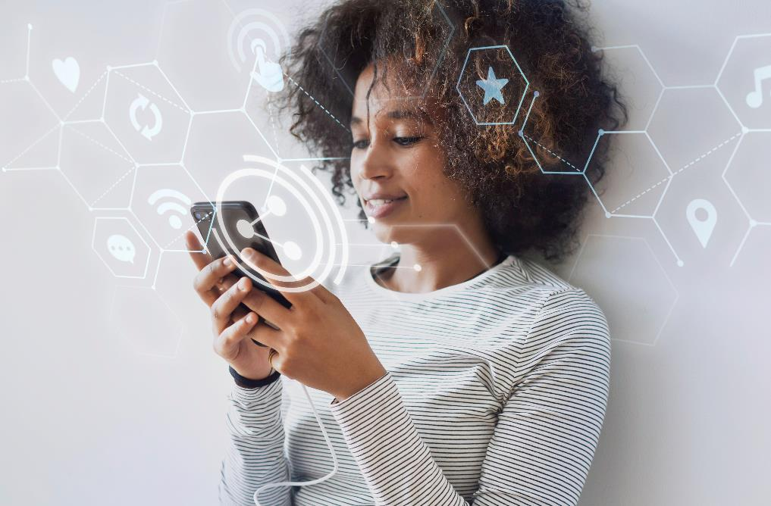
The Digital Self - Impact of Digitalisation on Personal Identity
Users and platforms create not only personal data traces or data shadows, but also digital selves, the presence of individuals in the digital sphere which goes far beyond a mere extension of their analogue appearance.
There are 4 situations where your personal identity is digitalised.
Find out more in the next slides
SOURCE:https://civilresilience.net/en/das-digitale-selbst-politische-bildung/

Slide 33
The Digital Self - Impact of Digitalisation on Personal Identity
1. Technical Environment
People typically install numerous apps, using on average ten daily and more than thirty in a month (AppAnnie, 2017).
“It is easy to go into a forest but challenging to find the way out”.
The app and data ecosystems are similar. Many efforts intend to make things user-friendly from the very beginning. However, with every new app, update, feature, app authorization, control may become more challenging and confusing, personal identity shared to some extent. We need also to consider, which data these apps are producing, how safe they are or if their analytical are reliable.

Slide 34
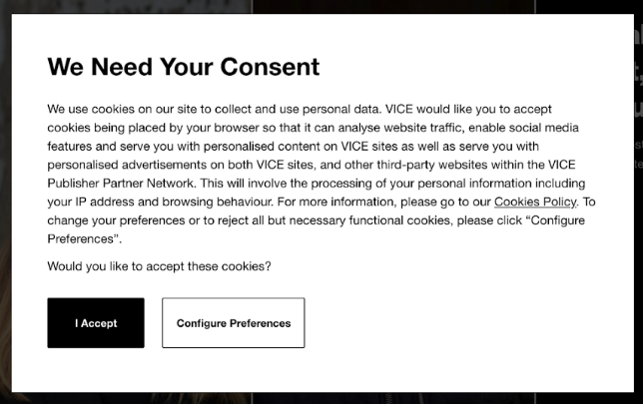

The Digital Self. Impact of Digitalisation on Personal Identity
2. Applied Behavioral Psychology
Supported by techniques from the methodology of behavioral psychology (like implementing gamification elements), the behavior of people is influenced.
Very visible are manipulative user interface designs to make people consent to their sharing of data or buying things, so called dark patterns.
A common example is that the button for giving consent to third-party cookies is more colorful than the button for the minimal settings. Other examples are trying to make people click on supplements or installing unnecessary software. Also known are warnings with messages like ‘only a few offerings for that price left’.
Dark patterns

Slide 35
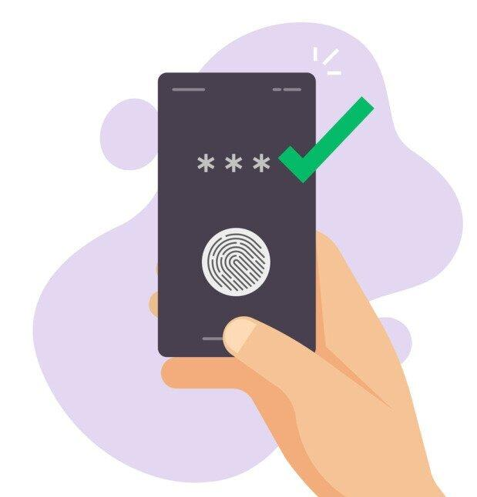
The Digital Self. Impact of Digitalisation on Personal Identity
3. Identification & Biometry
Biometry is technology aiming to identify a person through their personal characteristics or body features. It compares real body characteristics with stored data.
Since biometry was a domain of state data processing for a long time, the technology has become a standard feature for identification in smartphones and computers.
Many of these data are shared with third parties.

Slide 36
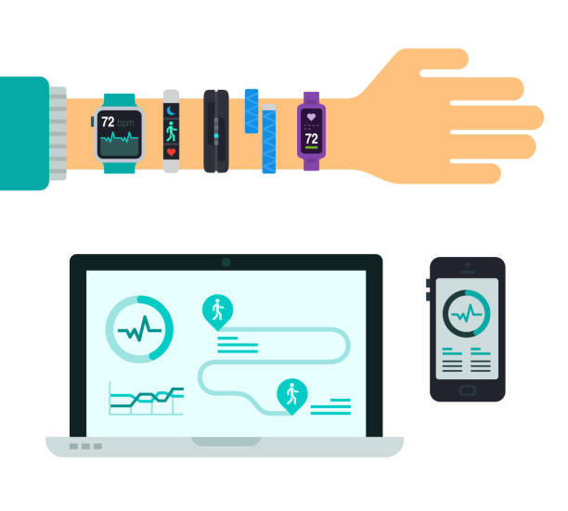
The Digital Self - Impact of Digitalisation on Personal Identity
4. The Body
Smartphone, watch or fitness tracker are demonstrating that smart body machine interaction left the therapeutical (or military) purposes for which they were often invented and swept into the everyday culture. This has consequences for our self-perception as humans and of our abilities. It changes how we use our bodies.
It is no question that new media and technology have an impact on the brain and also on physical abilities.

Slide 37
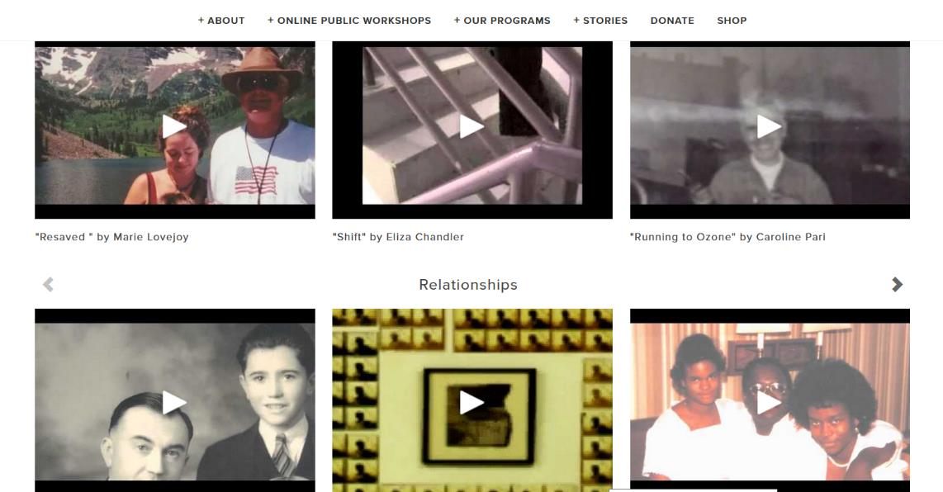

For your mental wellbeing – tell your story
As a refugee, migrant, expat, someone who moved countries and circumstances you hold worthy stories in you. It might be good for the wellbeing to share those stories. Female storytelling is relevant to the world. What you have to say, might not only help you feel more belonging, but could support someone elses yourney.
Here are some stories that couold inspire you: https://www.storycenter.org/stories

Slide 38

„
“They have no idea what it is like to lose home at the risk of never finding home again, have your entire life split between two lands and become the bridge between two countries.” — Rupi Kaur, Milk & Honey
„
SOURCE: https://msmagazine.com/2019/10/14/empowering-migrant-women-through-digital-storytelling/
PHOTO SOURCE: Microsoft stock images

Slide 39
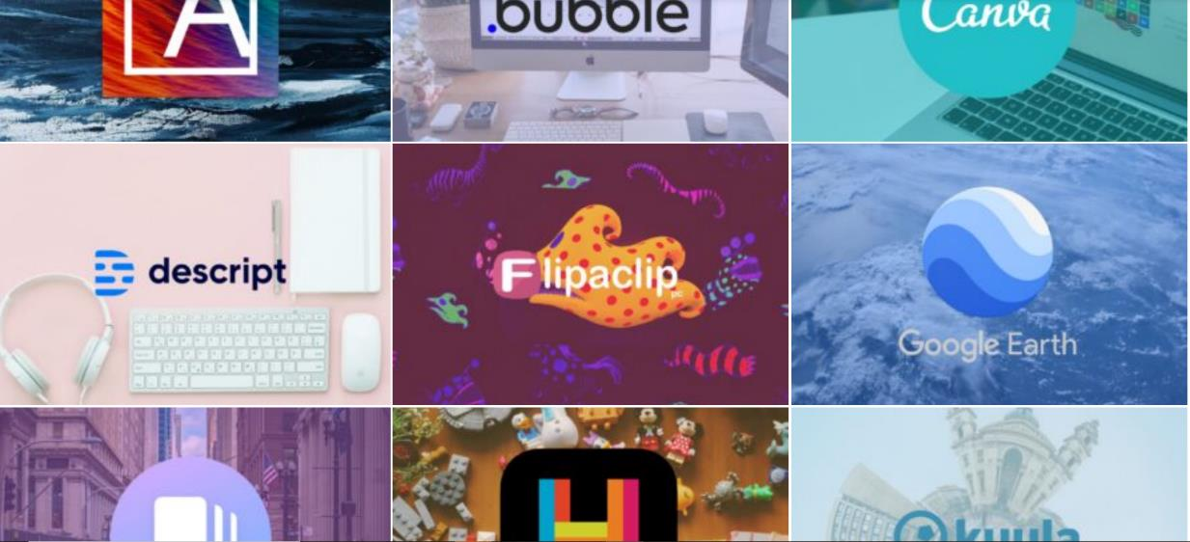
Digital Tools for Storytelling
Do you prefer storytelling through text. Images, video or something else? Check out these digital tools, categorised in a neat way, so you can choose your preferred method: EU STORIES - https://eurostories.eu/toolbox/

Slide 40
IMPROVE WELLBEING - IMPROVE YOUR STUDY-AT-HOME ERGONOMICS
While studying from home, it’s important to maintain proper ergonomic supports to stay comfortable and avoid back and neck pain. Try achieving at least 70% of these:
Use a supportive, upright chair with padding if possible
Raise laptop with books or other sturdy items
Consider using an external keyboard/mouse to maintain proper arm and wrist positioning
If using a standing workstation, wear comfortable, supportive shoes
Incorporate frequent movement/stretch breaks throughout your day
https://www.rrc.ca/coronavirus/2020/08/11/how-to-make-your-study-at-home-space-ergonomic/

Slide 41
IMPROVE WELLBEING : 10 STRATEGIES FOR REDUCING YOUR SCREEN TIME
Technology has helped us become way more productive. It’s helped automate repetitive tasks and pinpoint when we’re most productive.
Also, it can be distracting and gets in the way of creative thinking. Even more worrisome, some believe that we’re straight-up addicted to technology. And, obviously, that’s not ideal for our mental and physical health.
Too much screen time can cause vision problems, impact our sleep, and encourage a more sedentary lifestyle. It can even lead to anxiety, stress, and depression.
Suffice to say, you need to reduce your screen time. That’s totally possible by implementing the following 10 strategies.

Slide 42

10 STRATEGIES FOR REDUCING YOUR SCREEN TIME
Track screen time and set time limits
You’re probably thinking that there’s no way that you’re getting too much screen time.
There are plenty of tools that will track how much time you actually spend starring at that glorious blue light.
Rescue Time monitors the sites and apps you frequently visit and for how long.
If you have an iPhone, just turn on the Screen Time function in the Settings app.
Android users can do this through the Digital Wellbeing tools located within Settings.

Slide 43
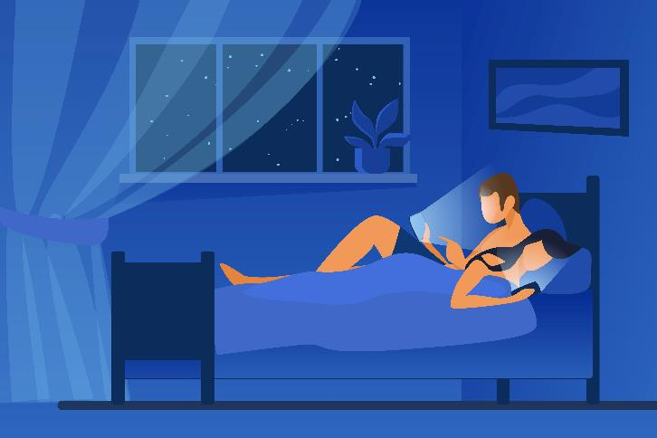
10 STRATEGIES FOR REDUCING YOUR SCREEN TIME
2. Keep your phone out of the bedroom
Many of us use our phones as alarm clocks, meaning they are the last thing we see at night. It’s also the first thing we see in the morning, perhaps even before our eyes are fully open. That blue light exposure can impact the quality of our sleep.
The solution? Charge your phone in another room and avoid looking at screens at least an hour before bed. And buy an alarm clock as well.

Slide 44

10 STRATEGIES FOR REDUCING YOUR SCREEN TIME
3. Establish tech-free zones
What other places should you designate as “tech-free zones?
The bathroom is on the top of the list. It’s unhygienic and just distracts you from doing your business and moving on.
The dining room or anywhere else you eat. Again, it’s gross and you can use this time more wisely like having quality time with your family or getting to know your team members better.

Slide 45
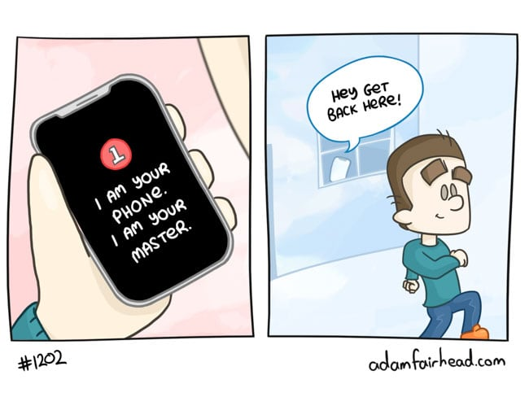
10 STRATEGIES FOR REDUCING YOUR SCREEN TIME
4. Leave your phone behind
If you were to contact me during off-hours, like during the evening or weekends, it’s going to take hours for me to respond. You might not even hear from me until the next day or two.
I’m not ignoring you. It’s just that my phone isn’t by my side.
If you gradually work your way up, you’ll notice that the world will keep spinning if you occasionally leave your phone behind.

Slide 46
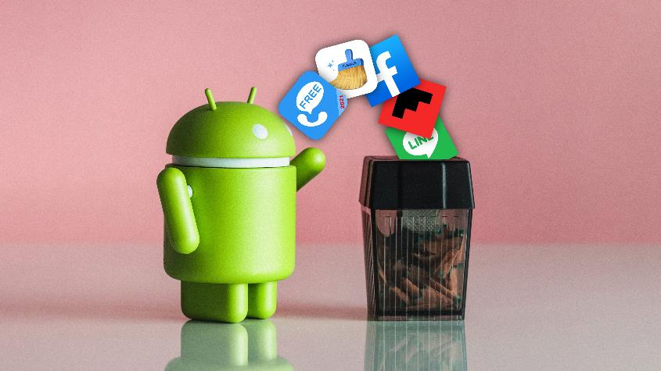
10 STRATEGIES FOR REDUCING YOUR SCREEN TIME
5. Remove unnecessary apps
When you have a couple of minutes, go through your phone and remove the unnecessary ones. For instance, if you only use social media for work, then uninstall them. The same goes for other apps that tempt you into mindless usage.

Slide 47
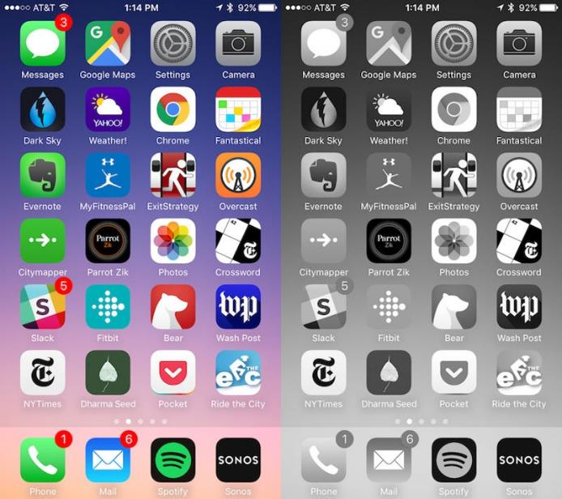
10 STRATEGIES FOR REDUCING YOUR SCREEN TIME
6. Switch to grayscale
iOS and Android allow you to turn your phone’s display grey. This will remove all the beautiful colours from your screen.
Why is this successful in curving your phone addiction? Because now they’ve lost their visual appeal.
For iPhone users, head into Settings. Select Accessibility > Display & Text Size > Color Filters. Android users can do this by opening up the Setting panels and going into Digital Wellbeing. Chose Wind Down and you can either turn Grayscale on now or schedule it for a later time.

Slide 48
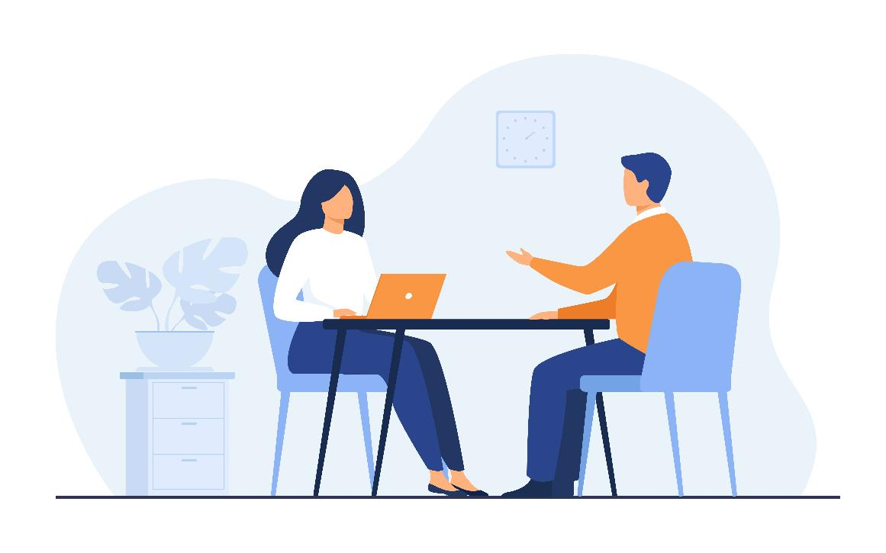
10 STRATEGIES FOR REDUCING YOUR SCREEN TIME
7. Schedule more face-to-face meetings
We know that Zoom and video calls are all the rage. They’ve been helpful, but they also cause fatigue.
Instead, set up an old fashioned phone call.
Or, even better, schedule a face-to-face meeting.
In-person meetings provide a sense of intimacy, connection and empathy that is difficult to replicate via video.

Slide 49
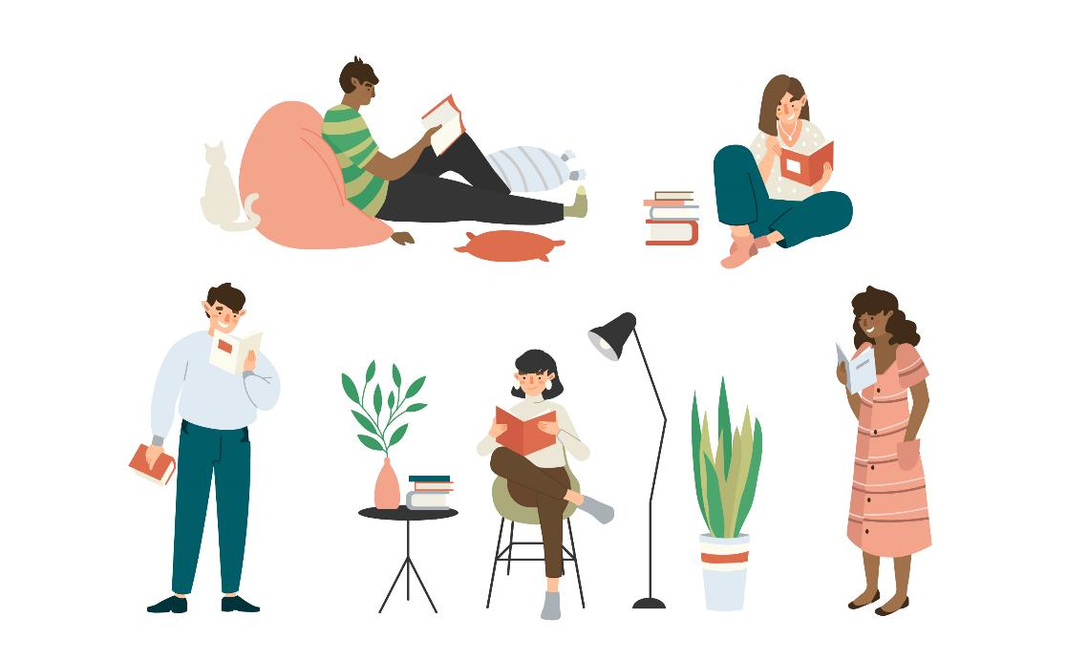
10 STRATEGIES FOR REDUCING YOUR SCREEN TIME
8. Take a look, it’s in a book
Believe or not, books and libraries are still in existence! We know it’s fast and convenient to use your phone or ask your smart device to answer a question. But, instead of relying solely on technology, seek out other ways to access information.

Slide 50
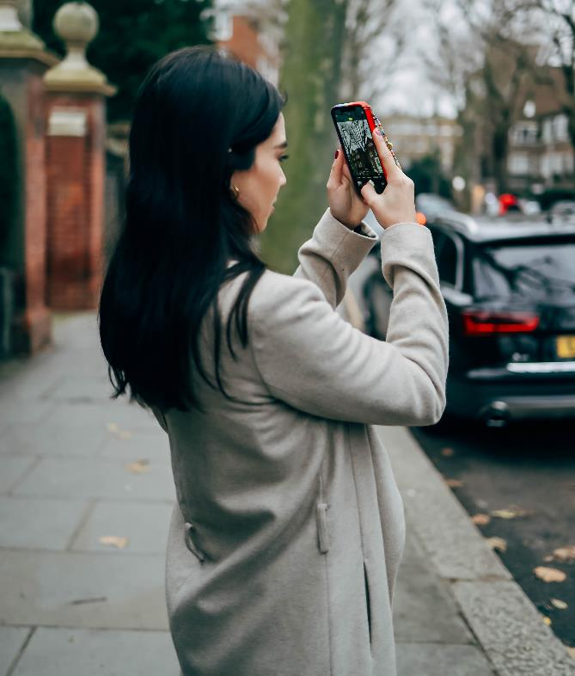
10 STRATEGIES FOR REDUCING YOUR SCREEN TIME
9. Don’t take as many pictures
For most of us, this has become second-nature. Regardless if you’re at a birthday party, sporting event, concert, or traveling you take an excessive amount of pictures.
Why is that a problem?
Well, three different studies have found that
photo-taking interferes with making new memories.
That’s not saying that you have to be anti-picture. It’s just that you don’t have to over snap. Instead, enjoy the moment by leaving your phone elsewhere.

Slide 51

10 STRATEGIES FOR REDUCING YOUR SCREEN TIME
“I’ve already cleaned the house and did a little work. But, now I’m getting bored. What do I do?”
Instinctively we grab a phone or laptop and just start browsing.
To combat this, pick up a new hobby that doesn’t require much screen time. Reading a book, any type of physical activity, or crafts are tech-free hobbies to engage with during downtime.
10. Pick-up a new hobby

Slide 52
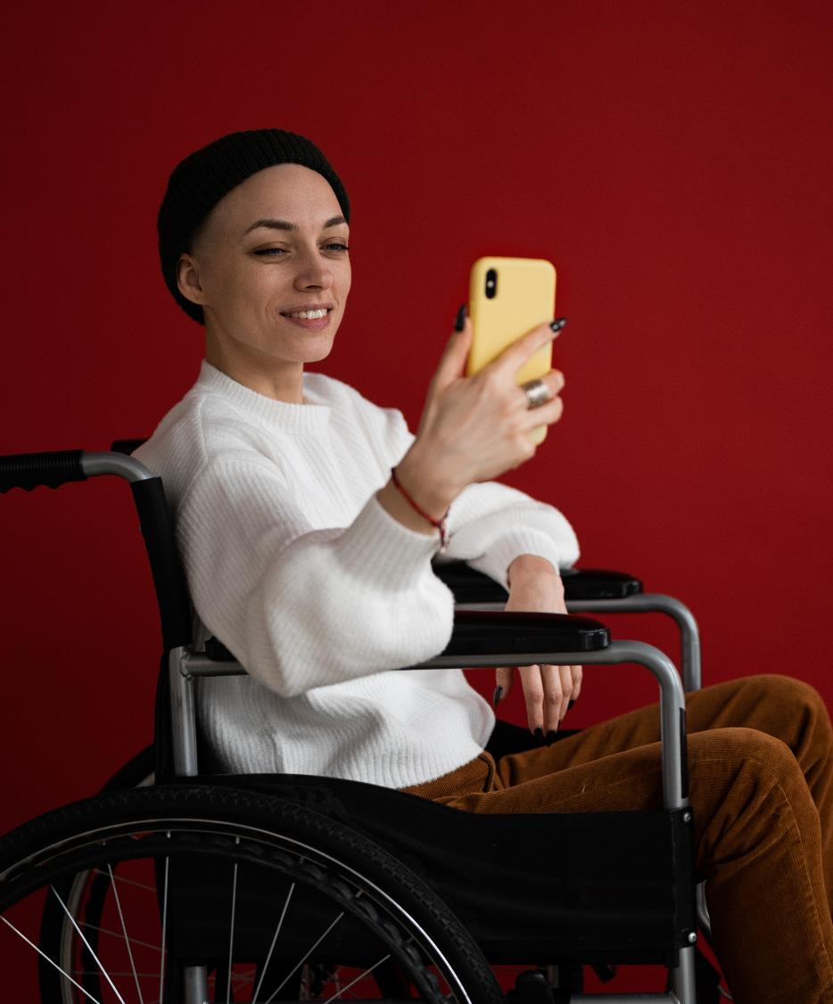
3. Protecting Devices

Slide 53
Important definitions
Internet security is a term that describes security for activities and transactions made over the internet.
Hacking is unauthorized users gain access to computer systems, email accounts, or websites.
Viruses or malicious software (known as malware) can damage data or make systems vulnerable to other threats.
Identity theft is where criminals can steal personal and financial information.

Slide 54


I am a migrant woman, my technology is more than just a device!
Migrant women are often connected to their friends and family at home via various chats, groups, social networks using their devices.
Your phone probably stores enormous emotional value, here is how to protect it and your other devices!

Slide 55
TASK!
The following 5 slides are your BOOKLET on online security.
Research each topic, follow the given links.
Print the next 5 pages and talk about them with student peers who are digital savvy
Try to implement some of these tips in the following 6 months

Slide 56
BOOKLET PAGE 1: Secure Your Wireless Router
These are a few steps you can do to set up your router and get better security:
Change the name of your router:
The default ID – Change your router name (SSID) to a name that is unique to you and won’t be easily guessed by others:
Change the preset passphrase on your router:
Leaving a default passphrase unchanged makes it much easier for hackers to access your network. You should change it as soon as possible. A strong passphrase is a sentence that is at least 12 characters long.
Review security options:
When choosing your router’s level of security, opt for WPA2, if available, or WPA – these levels are more secure than the WEP option.

Slide 57
BOOKLET PAGE 2: Secure Your Wireless Router
Create a guest passphrase:
Some routers allow guests to use networks via separate guest passphrases. If you have many visitors to your home, it’s a good idea to set up a guest network.
Use a firewall:
Firewalls help keep hackers from using your device to send out your personal information without your permission. While antivirus software scans incoming emails and files, a firewall is like a guard, watching for attempts to access your system and blocking communications with sources you don’t permit. Your operating system and/or security software likely comes with a pre-installed firewall, but make sure you turn on these features.

Slide 58

BOOKLET PAGE 3: How to protect your digital privacy?
If you are not a person with strong pc background and network skills, still you can do something to protect your digital privacy without huge knowledge about network security. Here are tips on how to keep your personal information secure online:
Think before you share
Everything you share online goes beyond your control — whether it’s a password, kid’s photo, or a late-night philosophical thought. Take a moment to consider the risks of sharing too much.
Lock your devices and cover your cameras
Don’t underestimate simple solutions when it comes to your privacy.
Use a VPN and security software (A virtual private network)

Slide 59
BOOKLET PAGE 4: How to protect your digital privacy?
Use unique, strong passwords and enable two-factor authentication, where possible.
The extra effort is justified when you want to protect your accounts from hackers or thieves.
Review privacy policies and app permissions
Check out the latest information about the way your personal data is collected and used. On your phone and tablet, review the apps’ access permissions and turn off anything you deem excessive.
Secure your smart devices
Make sure your home network and gadgets are protected by unique, strong passwords.
Check your data breach status regularly: https://www.f-secure.com/en/home/free-tools/identity-theft-checker

Slide 60
BOOKLET PAGE 5: Protect yourself with these tips:
Protect your €€:
When banking and shopping, check to be sure the sites is security enabled. Look for web addresses with “https://,” which means the site takes extra measures to help secure your information. “http://” is not secure.
Back it up:
Protect your valuable work, music, photos and other digital information by making electronic copies of your important files and storing them safely.

Slide 61
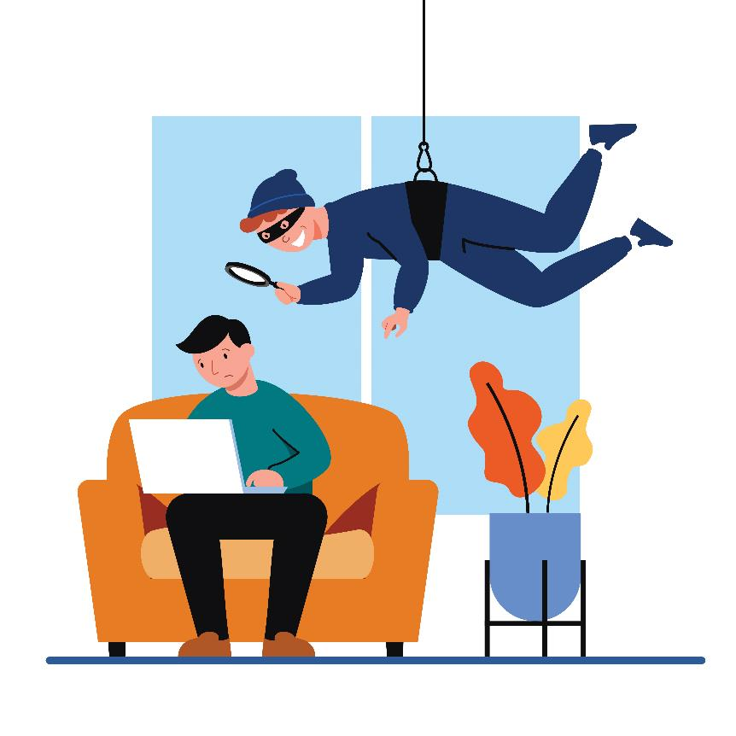
And finally, secure your Home Network
A protected home network means your can use the internet more safely and securely.
Most households now run networks of devices linked to the internet, including computers, gaming systems, TVs, tablets, smartphones and wearable devices that access wireless networks. To protect your home network, you need to have the right tools in place.
The first step is to keep a clean machine and make sure all of your internet-enabled devices have the latest operating system, web browsers and security software. This includes mobile devices that access your wireless network.

Slide 62

4. Protecting the environment

Slide 63
Important definitions
Digital pollution includes all sources of environmental pollution produced by digital tools. It is divided into two parts: the first is related to the manufacture of any digital tool, and the second to the functioning of the Internet.
e-Waste is electronic products that are unwanted, not working, and nearing or at the end of their “useful life.”

Slide 64
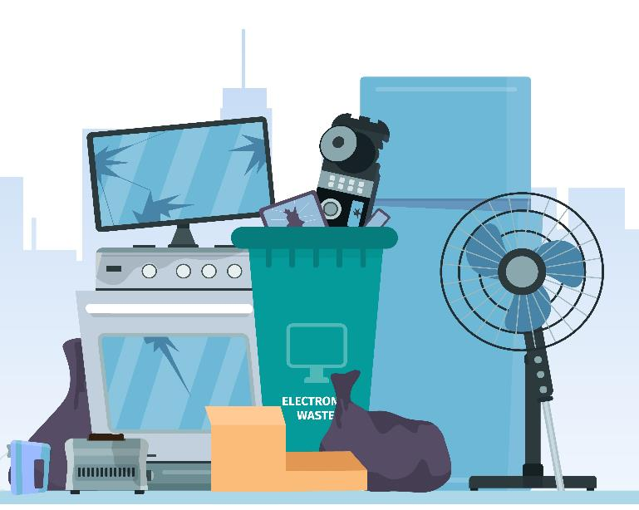
Environmental impacts of digital technologies
It is easy to think that digital technology is not damaging our planet, but in fact, it has one of the most significant negative impacts on the environment, when not managed well.
Let’s take a look at the following 4 aspects of digital technologies environmental impact:
After we are finished with our devices
How much electricity is too much electricity?
What is your device made of?
Impact of technology on space and outer space
https://www.ictworks.org/digital-technologies-climate-change-problem/#.YgT4XN_MKUk

Slide 65
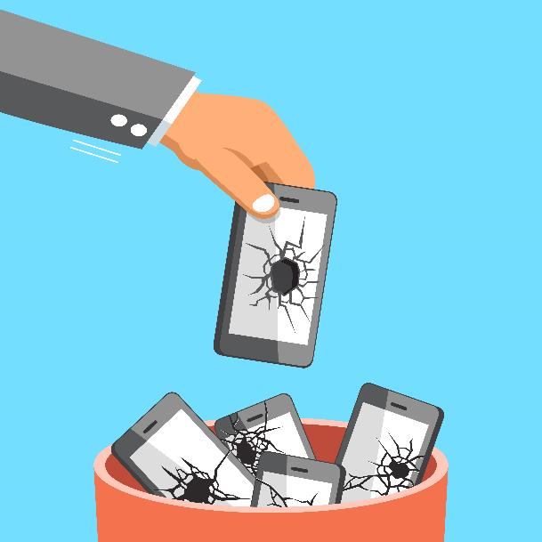
1. After we are finished with our devices
Redundancy and unsustainability are frequently built centrally into the digital technology business model. At least three key issues can be noted here:
Replacement Rather Than Repair
Most of the sector is based on the fundamental concept of replacement rather than repair. Also, many people replace their mobile phones at least every year or two. New models come out and new fashions are promoted.
Software Development Forces Hardware Upgrades
The hardware-software development cycle forces users to upgrade their equipment on a regular basis.
The Growing e-Waste Problem
Much e-waste contains concentrated amounts of potentially harmful products, and this shows little sign of abating.
https://www.ictworks.org/digital-technologies-climate-change-problem/#.YgT4XN_MKUk

Slide 66
2. How much electricity is too much electricity?
Digital technology must have electricity to function, and as industry and society become increasingly dependent on electricity for production, exchange and consumption, the demand for electricity continues to rise.
Four interconnected examples can be given of the scale of this environmental impact on climate change.
Electricity for Manufacturing Devices
Much more electricity is often consumed in manufacturing digital devices than in their everyday use.
Electricity for Digital Technology Use
Most measures of electricity demand focus on the direct uses of digital technology, such as powering servers, equipment and charging mobile devices (phones, tablets, and laptops), but indirect demand must also be recognised, notably the air-conditioning required to reduce the temperature of places running digital technology.

Slide 67

2. How much electricity is too much electricity?
Electricity for New Digital Technologies
Specific new technologies, notably blockchain, have been developed with little regard for their electricity demand and thus their environmental impact. For example, Bitcoin mining could be consuming the same amount of electricity every year as is currently used by the entire world.
Electricity for 5G and Internet of Things
Future projections relating to Smart Cities, 5G and the Internet of Things also give rise to additional concerns over energy demand. 5G, for example - the necessary denser networks - will place much heavier demands on electricity unless more energy-efficient technologies are put in place.

Slide 68

3. What is your device made of?
The unsustainable exploitation of many rare minerals is unsustainable environmentally and frequently based on labor practices that many see as lacking moral integrity.
Two aspects are important here.
Need for Rare Minerals
Most digital technologies rely on rare minerals that are becoming increasingly scarce. Many people are unaware, for example, that a mobile phone contains more than a third of the elements in the Periodic Table. Minerals such as Cobalt, the 17 rare earth elements, Gallium, Indium and Tungsten are becoming more and more in demand, and as supply is limited prices have often increased significantly.
Mining Rare Minerals
The actual exploitation of such resources is often hugely environmentally damaging. Mine tailings, open cast mining methods, and waste spillages are all commonplace.

Slide 69
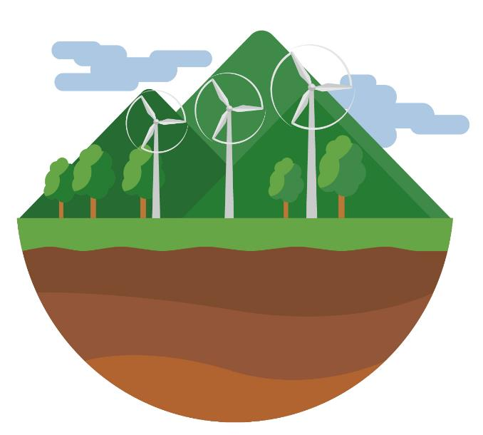
4. Impact of technology on space and outer space
Electrical Demand of New Technology
The renewable sources of energy would undoubtedly reduce the carbon impact of digital technologies, but their negative side-effects must also be taken into consideration. Digital technologies are crucial for smart motorways and self-driving electric cars. The shift to renewable production will lead to a very significant environmental impact through the construction of wind turbines and solar farms.
For example, wind farms would need to cover the whole of Scotland to power Britain’s electric cars.
SOURCE: https://www.ictworks.org/digital-technologies-climate-change-problem/#.YgT4XN_MKUk

Slide 70
4. Impact of technology on space and outer space
Expanded Physical Infrastructure
The impact of a large number of new cell towers and antennae that will be needed for 5G networks, as well as the buildings housing server farms and data centers also have a significant environmental impact.
It is not just the electricity demands for cooling that matter, but the sheer size of data farms also has a significant physical impact on the environment. The average data center covers approximately 100,000 sq ft of ground.

Slide 71

4. Impact of technology on air, space, and outer space
Proliferation of Satellite Constellations
Space is seen as having no relevance for environmental matters, rather like the oceans were once considered, but in reality, space pollution is very important to us.
The environmental impact of rockets that launch satellites into space has until recently scarcely been considered.
It is estimated that there have been about 8,950 satellites launched into space of which around 5,000 were still in space, with only 1,950 still functioning.
SOURCE: https://www.ictworks.org/digital-technologies-climate-change-problem/#.YgT4XN_MKUk

Slide 72

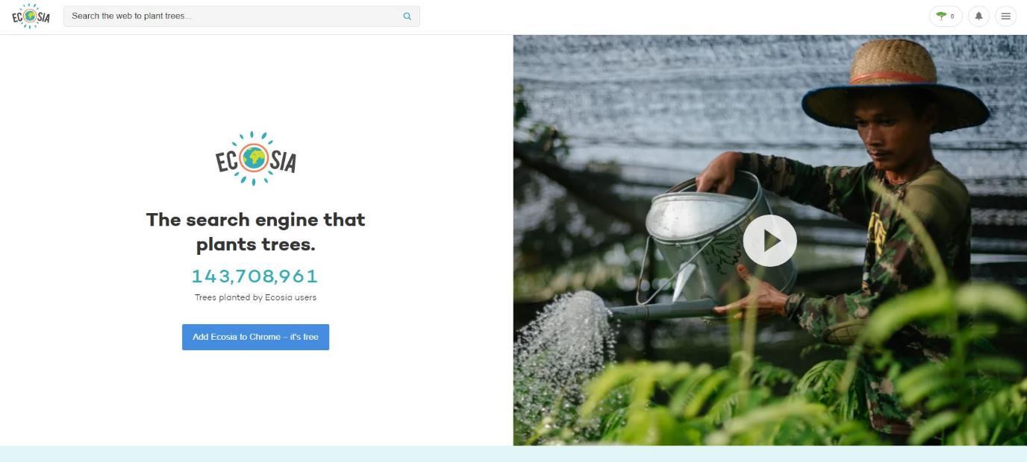
BECOME PART OF THE SOLUTION:
The search engine that plants trees
www.ecosia.org
FIND OUT MORE
Ecosia - the search engine that plants trees

Slide 73
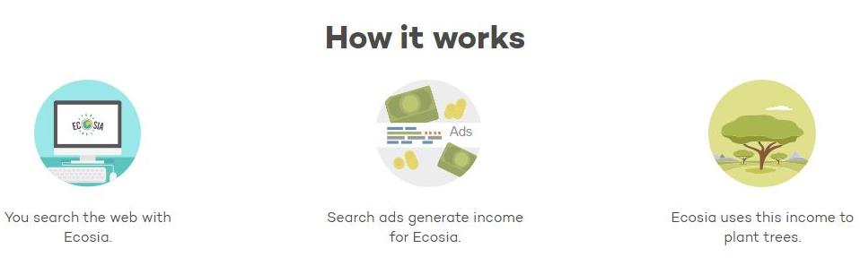
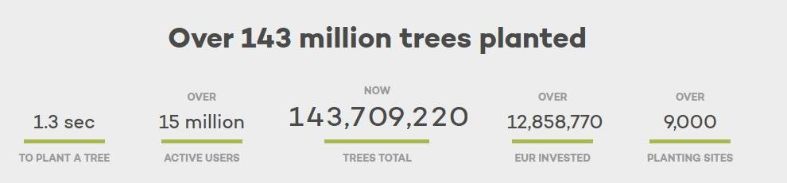
Plant trees while you search the web
Ecosia uses the profit from your searches to plant trees where they are needed most. Get the free browser extension and plant trees with every search.
Ecosia - the search engine that plants trees

Slide 74
Main conclusions to this module:
There are steps we can take to reclaim control of our digital identity and safety
Technology has effects on our mental and physical health, we must be aware of that and manage our behaviour regarding the technology usage
Our choices regarding digital technology affect our environment, it’s not insignificant

Slide 75
In Module 5, you learn about
Identifying needs and technological responses
Solving technical problems
Creatively using digital technologies
Identifying digital competence gaps

Slide 76
Thank you and congratulations on finishing Module 4!
www.includeher.eu

