Slide 1
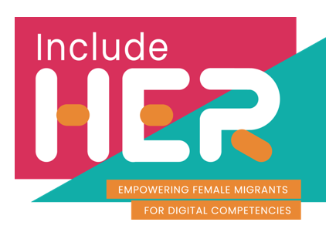
Welcome to
Module 3
Digital Content Creation
Part of our
INCLUDE HER Digital Development Resources
This programme has been funded with support from the European Commission. The author is solely responsible for this publication (communication) and the Commission accepts no responsibility for any use that may be made of the information contained therein 2020-1-DE01-KA203-005668

Slide 2
Overview, how you will benefit
Developing digital content
1
Module 3 will provide learning on how to create and edit digital content in different formats, to express oneself through digital means, to modify, refine, improve and integrate information and content into an existing body of knowledge to create new, original and relevant content and expertise, to understand how copyright and licenses apply to data, digital information and content.
We will also explain how to implement the knowledge from this module into higher education studies.
Integrating and re-elaborating digital content
2
Understanding copyright and licenses
3
Programming – quick solutions
4

Slide 3
1. Developing Digital Content

Slide 4
Creating and editing well-defined content
As a student and later in your career development, you are constantly expected to create well-defined, high-quality content. Very often, this needs to be creative. Whether you are summarising your research, presenting your findings, looking for opportunities, communicating your points of view, connecting to others, mastering content creation is what makes everything else easier.
There are 3 main phases in content creation:
Content research and planning
Content developing
Content sharing
Creating content for consuming in a digital format requires a defined approach, therein the theme of this Module of learning!

Slide 5
But first, important definitions –what do we mean by ‘digital content’
Digital content is any type of content that exists in the form of digital data that are encoded in a machine-readable format, and can be created, viewed, distributed, modified and stored using computers and digital technologies, e.g. the internet. The content can be either free or pay content. Examples of digital content include: web pages and websites, social media, data and databases, digital audio, such as Mp3s, and e-books, digital imagery, digital video, video games, computer programmes and software.
Content is created in different formats e.g. text document, graphics, images, video, music, multimedia, web-pages stored using a standard file format, 3-D printing. File formats can be either licensed, free and/or open.

Slide 6
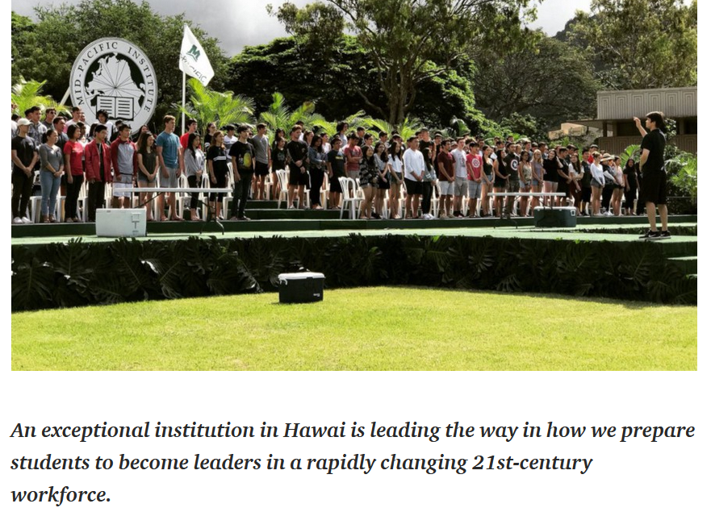
Read the article: Teaching Students to Create Content Not Just Consume it
CLICK on the image TO READ

Slide 7
To create your desired content, you first need to do some research on the topic and do some planning.
On the following slides, we bring you 5 steps to guide you through that process.

Slide 8
Content research and planning:
Systematic research procedures end in summarizing and synthesizing
Crafting your search terms and queries
Specify
Search
Synthesize
Specify the desired objective
Survey
Select
Be fully aware of the search tools available in their academic disciplines
Select the most relevant and accurate content
SOURCE: https://www.facultyfocus.com/articles/online-education/helping-students-develop-digital-content-curation-skills/

Slide 9
RESEARCH
What types of questions am I trying to answer as a result of my search?
What are the criteria that define a successful search?
1
SPECIFY
At the beginning of any journey, it is important to specify the desired destination.
This is also true when looking for information.
Students should start by stating what they want
SOURCE: https://www.facultyfocus.com/articles/online-education/helping-students-develop-digital-content-curation-skills/

Slide 10
RESEARCH
What type of information is being sought (e.g., general information queries, academic journals, books, conference presentations, video/audio)?
What subscriptions to academic databases are available?
2
SURVEY
If searches are related to common, everyday topics, then “Googling it” would suffice.
At the same time, however, if searches are related to disciplinary or research topics, those with greater levels of nuance and sophistication, then students should be equipped to take advantage of varied and specialized search tools (e.g., EBSCOhost, PsycINFO, PubMed/Medicine).
SOURCE: https://www.facultyfocus.com/articles/online-education/helping-students-develop-digital-content-curation-skills/

Slide 11
Google Scholar provides a simple way to broadly search for scholarly literature
https://scholar.google.com/

Slide 12
RESEARCH
The next step is to search for sources.
While everyone knows how to Google for information, many do not consider how they are crafting their search terms and queries.
3
SEARCH
What types of search terms and queries will yield the best results?
What are the expectations for this search process (e.g., number of potential resources, variety of sources?)
SOURCE: https://www.facultyfocus.com/articles/online-education/helping-students-develop-digital-content-curation-skills/

Slide 13
RESEARCH
There are variety of online tools to assist students in creating these graphic representations of their planned project, for example Coggle
4
SELECT
What types of strategies could be used to assess and verify the quality of collected information?
Is there an openness to the possibility that final conclusions might be contrary to or change initial hypotheses?
SOURCE: https://www.facultyfocus.com/articles/online-education/helping-students-develop-digital-content-curation-skills/

Slide 14
RESEARCH
The ability to summarize an author’s position is critical to validating its accuracy, as it often alerts students to gaps in the author’s reasoning
5
SINTHESIZE
Systematic research procedures should end in a process of summarizing and synthesizing the works found.
You will find various resources. Students often just draw all their research into one report. We suggest you first summarise each resource. By looking at the main point each resource is making, you will have a better understanding of the overall research and will be able to spot the relationship between these resources and their points.
SOURCE: https://www.facultyfocus.com/articles/online-education/helping-students-develop-digital-content-curation-skills/

Slide 15
Once you have done your research and planning, you will know more about the content you are about to create.
Now it is helpful to craft your message, your unique way of forming the content and presenting the information.

Slide 16
Content research and planning
Please reflect on these 6 steps to CRAFTING AN EFFECTIVE MESSAGE
Open with a statement that engages your audience. Make a statement that gets your audience’s attention right away, perhaps using a dramatic fact. This is your lead-in and should be only a sentence or two.
Present the main point. Describe the main point, who it affects, it impacts
Provide facts about your message (proof/evidence). Data is important to demonstrate that a problem exists and to support your position. Look for facts that are relevant to your audience.
STEP 1
STEP 3
STEP 2

Slide 17
Content research and planning
Please reflect on these 6 steps to CRAFTING AN EFFECTIVE MESSAGE
Share a story or give an example of the problem. An example or story puts a human face on the issue and makes it real and more compelling. Again, make sure the example is relevant to your audience
Connect the issue to the audience’s values, concerns or self-interest. Show your audience how this interest fits with what they care about, want or need
Conclude and summarise, think about different formats you could communicate this message through (text, images, video, etc.)
STEP 4
STEP 6
STEP 5

Slide 18
Content development
Content is the currency of the learning path. There are many ways that students can focus on creating to connect with peers, present work, find networking opportunities, complete tasks in a creative way, pitch projects and more.
We are going to go over the top 5 content types for use in a digital sphere and best practice approaches to
Text
Images
Video
Presentations
Websites

Slide 19
The advantages of being a female student with migration background for content creation
Content creation is all about the perspectives, insight and creativity. As someone who has had different and rich experiences, due to the migration background, you can provide fresh views on many subjects. Whether you are creating content for a course, an out-of-curriculum activity, or something else, you should be aware that there is great opportunity for an out-of-the-box thinking. Embracing this will add quality and advantage to the content you create.
Examples:
You can research and use resources from several countries, probably using several languages
You can implement intercultural approach to the content you are creating, checking it against the values and aestethics of more than one culture. This deepens the value of the content
When creating content, you can challenge the views, pose fresh questions, challenge the status quo

Slide 20
1. Content in form of Text
Wether you are using storytelling or technical writing to create textual content the most important 3 pillars to follow are:
Grammar needs to be of excellent standard. Proofreading: use a grammar software App and combine it with a peer support
Style – depending on the type of content, getting skilled at different writing styles is a skill for life, especially differentiating between formal and non formal styles. Click HERE to find out more.
Creativity – Creating something implies you will rely on your creative side. Each content piece has an angle, you can be creative in choosing the angle of your writing. Curiosity is the key to creativity! Also build in empathy in anything you are writing, this will improve all written content!

Slide 21
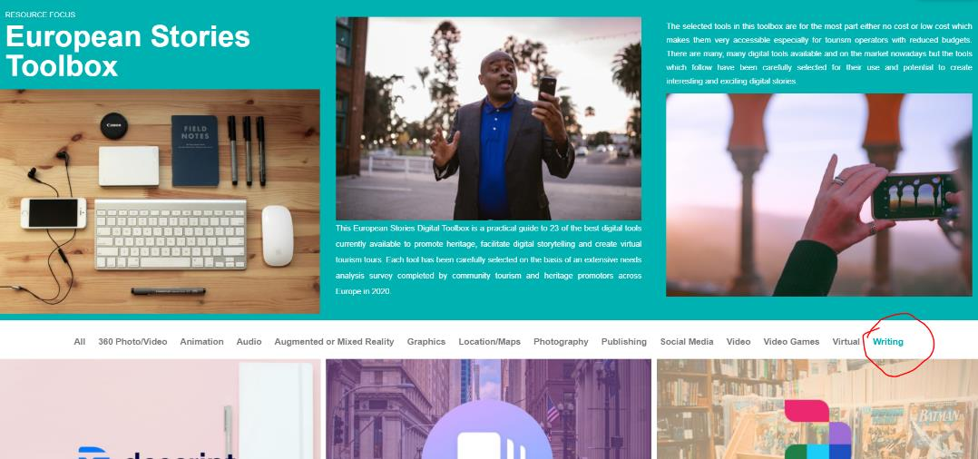
TOP TIPS
To write, you will need tools that will lift your words towards engaging content. Go to Eu Stories Project tools and select WRITING. There are 9 digital tools presented there, that will support you with creating creative text.
Grammarly – sign up for a free version and get an automated virtual proofreader, that will eliminate any grammar mistakes
CLICK TO get INSPIRED

Slide 22
Expressing ourselves through the creation of digital content:
Importance of voice and tone of voice
We empower text content by being aware of our voice and our tone.
What’s the difference between voice and tone? Think of it this way: You have the same voice all the time, but your tone changes. You might use one tone when you're out to dinner with your closest friends, and a different tone when you're in a classroom presenting your project.
Your tone also changes depending on the emotional state of the person you’re addressing. You wouldn’t want to use the same tone of voice with someone who’s scared or upset as you would with someone who’s laughing.

Slide 23
2. The Power of Images
The old saying still pertains - a picture speaks a thousand words. To find the perfect image for your piece of content, you have three choices:

Slide 24
Find a free stock photo you have the rights to use. Great sites include Beautiful Free Images & Pictures | Unsplash and 2.4 million+ Stunning Free Images to Use Anywhere – Pixabay
Buy a high-quality stock photo you have the rights to use. Stock Images, Photos, Vectors, Video, and Music | Shutterstock
Watch this short video that captures the power of the image
Create an image yourself. You can also commission photography, but it can be expensive.
Top tip: learn about licences on images in the following topic: Understanding copyright and licenses

Slide 25
TOP TIP: Use Canva to present your images
Canva is a really simple tool you can use for enhancing your images. It is a powerful tool for visual storytelling and can be easily customized with a choice of fonts, backgrounds, frames and more.
Watch the video to find out more about it!

Slide 26
3. The Power of Video
Consider this marketeer’s claim.
Videos get 1,200% more shares than text and images combined. People love sharing content on social media and more importantly: people love sharing videos. If made right, videos can take information and make it easy to interpret in a short amount of time. It’s been said that one-minute video is worth to 1.8 million words.
READ MORE 5 Reasons Why Video Is More Effective than Text - IdeaRocket (idearocketanimation.com)

Slide 27
How to use your video editing skills?
Video editing skills can be particularly useful:
To record and edit short presentations – In the past few years, online presentations have become more and more common, and you are very likely to be asked to record your presentation as a video, or to edit the recording of a presentation that you did as part of an online class, meeting or event.
To create your own video content – The video format has become very popular for all types of communications. You may thus want or have to create your own videos.
To improve your job prospects – Video editing skills are in demand on the job market. Having basic skills could improve your CV… and your job prospects!

Slide 28
Creating videos on Canva is a great start
Click to watch
Canva is a useful tool to edit short videos easily. Through this video you will learn to :
Trim videos Put different clips togethers
Add music And download your video for further use

Slide 29
WATCH
4. Presentations
How to avoid death By PowerPoint | David JP Phillips | TEDxStockholmSalon
The main purpose of a presentation is to inform. It is a fact of modern life that attention spans are generally shorter and conference organisers claim that only 35% of what is presented will be absorbed by the average audience who are paying attention to presentation.
Some insightful articles…
How to Deliver Powerful Short Presentations (mikogo.com)
19 Ideas for More Compelling and Effective Presentations (circlesstudio.com)

Slide 30
PRESENTATIONS
EXERCISE
Create engaging slides!
6 dos and don’ts for next-level slides
Read carefully this article: “6 dos and don’ts for next-level slides, from a slide expert” https://blog.ed.ted.com/2019/08/26/6-dos-and-donts-for-next-level-slides-from-a-slide-expert/
Think about:
What did you learn from this article?
Why is it important to have high-quality slides?
What is the most important information you want to remember from each do and don’t?

Slide 31
EXERCISE
Create engaging slides!
Choose your presentation software
Explore the following presentation software and select one you would like to test, keeping in mind the recommendations you have read in the article:
Microsoft PowerPoint Prezi Canva
Click on the logos to learn more.

Slide 32
EXERCISE
Create engaging slides!
Get started
Using the presentation software of your own choice and following the recommendations of the article, create the 2 first slides of a presentation summarising the main points of the article.
Share the slides with your classmates/colleagues to get their feedback!
A few points to reflect on to evaluate the quality of the slides:
What did you learn from those slides?
Does the presentation stick to the rule: “one idea per slide”?
Are the slides legible?
How would you rate the quality of the visuals?
How fast do you understand the idea behind each slide?

Slide 33
Websites
There are so many tools that you can use to create a digital platform for your content. Let’s investigate these options:
WORDPRESS, WIX and SQUARESPACE
CLICK TO watch the video
Watch this short tutorial to get some orientation

Slide 34
Try WIX to build your web site, watch this short tutorial to get some orientation

Slide 35
Try SQUARESPACE to build your web site, watch this short tutorial to get some orientation

Slide 36
Content sharing
After research and planning for content, followed by content development, come time for sharing your content.
There is a lot to choose from: the platform you will share on, the time, the people.
Remember again what you wanted to achieve and what platforms would give you the best chance to reach your goals.
Try to predict what kind of reactions you expect and manage your, and try to manage your expectations and emotions about the feedback

Slide 37
Sharing plays an important role in building a positive classroom community.
Just as important, sharing offers ample opportunities to practice and reinforce the speaking, listening, and thinking skills that are so crucial to studying success.
Click on each point to read about real examples of content and the platforms being used for sharing in higher education
User-generated and user-centered content
More human, conversational and accessible content
Story-based, multi-platform content
Long-form videos
Data-driven visual content

Slide 38
Remember from MODULE 2: The advantages of being a female student with migration background for content sharing
Content sharing is all about the reach and the relevance of the target group. Please remember the opportunity you might have regarding the reach, simply due to the fact that you are a female student with migration background:
You might have knowledge and acces to some international or abroad higher education institutions, that might be interested in recieving your content and collaborating with your current higher education institution
You might have access to intercultural social media groups, to students, who are supporting each other in their inclusion and integration processes
Female networks and networking events are on the rise, which is good news. You could sign up to online and offline networking events, thus gaining new opportunities and platforms for content sharing.

Slide 39
2. Integrating and re-elaborating digital content

Slide 40
Being efficient also means not creating new content if it’s not necessary. You could simply refer to other existing content, modify and integrate it into your own context.
Be sure to respect the copyright and licenses (see the next chapter of this module)

Slide 41
Task
Create a short video using Canva
Using the slides of this course, create a short explainer video in Canva
Choose from the Canva templates
Choose slides that cover one topic
Put those slides in a different context and pretend you are making this video for a target group of senior professors
Add more images, using one of the previously mentioned stock image websites
Show this video to your fellow students and your educators and elaborate the new purpose of the video

Slide 42
Top tip:
Modify, refine, improve and integrate information and content into an existing body of knowledge to create new, original and relevant content and knowledge by using platforms such as Ted ED.
TED Ed allows creating lessons and student talks from exhisting Ted or You Tube videos

Slide 43
Creating a TED-Ed lesson is easy!
Find a video
Add questions, discussion prompts, and additional resources
Share your lesson with your peer students
Track their progress
CLICK TO watch the video
The TED-Ed Student Talks Program supports students as they discover, explore and present their big ideas in the form of short, TED-style talks.

Slide 44
3. Understanding copyright and licenses

Slide 45
Important definitions
Copyright is an intellectual property right (IPR) that grants authors, artists and other creators protection for their literary, artistic and scientific creations, generally referred to as “works”
Licenses are permissions given by the copyright holder for their content. Licenses can be applied to copyrighted material in order to give permission for certain uses of the material. Copyright is still held by the creator in these cases, but the creator has decided to allow others to use their work. Sometimes licenses are purchased and sometimes they are given freely by the creator

Slide 46
Important definitions
Creative Commons licenses are applied by the copyright owner to their own works. It is a type of copyright license which is free and allows creators to give permission for others to use the work under certain conditions.
Copyright is a branch of Intellectual Property Law (IP Law). IP Law protects a wide range of rights in various results of human creativity. Other major branches of IP Law include: Patents, Industrial Designs, Trademarks and Trade secret.

Slide 47
WATCH THE VIDEO: The Difference Between Copyright Ownership and Copyright License,
Minute Law|Spear IP
CLICK TO watch the video
SOURCE: https://www.youtube.com/channel/UC5QigptZiCIvkpe-LCyzyXQ

Slide 48
Copyright licensing is a common method for gaining and transferring rights of copyright works. If you wish to use copyright material, you usually need to get permission from the rights holder to do so
TYPES OF COPYRIGHT LICENCES
Exclusive license
Limited use license
Creative Commons license
Collecting societies
Read about each type here: https://www.nibusinessinfo.co.uk/content/different-types-copyright-licences
Read the Copyright Law in the EU: https://www.europarl.europa.eu/RegData/etudes/STUD/2018/625126/EPRS_STU(2018)625126_EN.pdf

Slide 49
Top tips
Do not download and use You Tube videos if that is not strictly allowed by the author
Be careful about downloading – check if it’s allowed, then also check what licenses for further usage have authors places on the content
Ask your educators to refer you to your university plagiarism rules
Be aware that there are plagiarism software available, such as this one: https://plagiarismdetector.net/

Slide 50
4. Programming – quick solutions

Slide 51
Important definitions
Computer programming - creating a sequence of instructions to enable the computer to do something
No-code development platforms allow programmers and non-programmers to create application software through graphical user interfaces and configuration instead of traditional computer programming

Slide 52
No-code development platforms provide drag-and-drop tools that enable businesses to develop software quickly without coding. The platforms provide editors and drag-and-drop components to quickly assemble and design applications. Both developers and non-developers can use these tools
PROGRAMMING –WHY?
Coding has emerged as the number-one in-demand skill in recent years, but it can be a challenging task to learn coding, and the solution we recommend is to go around it by using no-code ready made tools, to build the solution you might need.
Mastering skills that fall under machine programming, can be your competitive advantage as a future employee, or help you create projects for your studies

Slide 53
Learning to code is not too easy and it is a time-consuming process.
Luckily, due to technological development, there are no-code tools, that allow performing activities in the programming, and are user friendly

Slide 54
No-Code Development Platforms will offer no source code access or code modification capabilities
A no-code tool is a system that allows programmers and non-programmers alike to implement digital apps and software using configuration and user interfaces.
In short, it allows you to get the most out of platforms without extensive coding knowledge.

Slide 55
Here are the 3 tools that can substitute for coding.
They could be helpful to simplify administration processes in studies, encourage higher student engagement and personalise individual experiences.

Slide 56
Testimonial
Watch the videos to learn about
Blackboard
Tutorial
Blackboard- In light of the COVID-driven school closures, Blackboard has released a temporary tool to help students transition to digital learning. The new tool helps with the accessibility of digital files and allows students to convert files to a range of formats that were previously unavailable. HTML, audio MP3, ePub, Beeline Reader, and electronic Braille are all included.​

Slide 57
Watch the videos to learn about
Moodle
Testimonial
Tutorial
Moodle - Moodle is where students can share and compare feedback, open forums and jump on eLearning tools on-the-go.

Slide 58
Watch the videos to learn about
Bubble
Testimonial
Tutorial
Bubble lets you create interactive, multi-user apps for desktop and mobile web browsers, including all the features you need to build a website

Slide 59
CASE STUDY | KONEIXO: TRAINING MIGRANTS AND REFUGEES TO BECOME DIGITAL PROFESSIONALS

Slide 60
Konexio’s training is providing practical skills to women, therefore boosting their self-confidence and connecting them with the professional world.
→ Programming is accessible to all motivated learners with only basic digital skills
Konexio and Women in Digital
Konexio is a hybrid non-profit and social start-up that provides digital and programming skills training to refugees and migrants with the aim to develop their employability.
Konexio’s training programmes take into consideration specific barriers faced by migrants and refugees.
SOURCE: Konexio http://www.konexio.eu/en.html?lang=en

Slide 61
How it was done
Konexio’s training follows a customised, blended learning approach, pairing in-person course with an e-learning interactive platform.
They include simulations of practical case studies based on real-life scenarios and put a strong emphasis on soft skills.
Konexio brings a direct link with the professional world thanks to its network of partner companies.
The training is complemented with an adaptive and comprehensive support to avoid career breaks and encourage networking.
Special attention is given to the specific barriers faced by refugees and migrants.

Slide 62
What to keep from Konexio’s approach?
Recommendations for digital skills and programming training:
As a student try to ebmrace opportunities for blended learning approach, combining face-to-face training with e-learning participative activities.
Adopt soft skills based on available case studies – learning from others compesates for any lack of our own personal experiences – connect with others
Foster opportunities for networking
Try to think about your career path in advance
Look for opportunities for social integration and inclusion

Slide 63
RESOURCES
If you need help with your no code project, or you do decide you find some coding interesting, but get stuck, the resources on the right will help you move forward – just ask questions on their platforms
FINDING HELP WITH PROGRAMMING
YouTube:
Thenewboston - Node.js, Angular, Java, C, and more
Derek Banas - C#, Python C++, and more
DevTips - Design, General Tips, Great CSS explanations, and more
Sites & communities
Quora
Reddit
StackExchange
CodeProject

Slide 64
Conclusions to this module
The social skills, soft skills, communication skills are important to us as social beings, as individuals, groups as students.
The fastest and most efficient way to communicate an idea, finding, information is to create and share digital content
It has long been thought that a student-centered project that ends with students creating a piece of material engages the student because of the sense of ownership to the final piece. This has not changed today; yet, in a world where students are surrounded by digital content and rich media, it may be more engaging and motivating for them to create projects that are digital and can compete with the digital world they live in.

Slide 65
In the next module learn how to:
Protect personal data and privacy in digital environments, specifically:
Using and sharing personally identifiable information while protecting oneself and others from damages
Understanding that digital services use a “Privacy policy” to inform how personal data is used
Avoiding health risks and threats to physical and psychological wellbeing while using digital technologies
Protecting oneself and others from possible dangers in digital environments (e.g. cyberbullying)
Being aware of digital technologies for social wellbeing and social inclusion
Protecting devices and digital content
Understanding risks and threats in digital environments
Knowing about safety and security measures and to have due regard to reliability and privacy
Being aware of the environmental impact of digital technologies and their use

Slide 66
Thank you and congratulations on finishing Module 3!
www.includeher.eu

