Slide 1



Welcome to
Module 1
Information and data literacy
Part of our
INCLUDE HER Digital Development Resources
This programme has been funded with support from the European Commission. The author is solely responsible for this publication (communication) and the Commission accepts no responsibility for any use that may be made of the information contained therein 2020-1-DE01-KA203-005668

Slide 2


Data Literacy as a Human Right
Digital citizens should receive access to their personal data. Moreover, they must be equipped with critical abilities to understand how data-power structures can influence their lives. Thus, we must not only view access to data literacy as an additional element of the educational curriculum.
We must view it as a human and civic right. Just like the traditional form of literacy, which is often understood within a rights-based approach and among principles of inclusion for the Global Goals for Sustainable Development.
Homework: Which of the Global Goal for Sustainable Development aims fits best with data literacy need? CLICK on the circle TO LOOK THROUGH THEM ALL
SOURCE: https://impakter.com/human-rights-in-the-digital-age-data-literacy-in-tackling-the-big-data-divide/

Slide 3

Europe's Digital Decade
The EU will pursue a human-centric, sustainable vision for digital society throughout the digital decade to empower citizens and businesses.
Digital Decade in a nutshell:
https://ec.europa.eu/info/strategy/priorities-2019-2024/europe-fit-digital-age/europes-digital-decade-digital-targets-2030_en

Slide 4
WELCOME to the Include her Open Education Resources, a unique gender and culturally aware approach to digital skills development of female migrant higher education students
We hope you enjoy these ready-to-use learning activities

Slide 5
Overview, how you will benefit
Browsing, searching, filtering data, information and digital content
1
In Module 1, our learners will find out how to articulate information needs, how to search for data, information and content in digital environments, and how to access and navigate between them.
To create and update personal search strategies, we will guide learners on how to analyse, and critically evaluate the credibility and reliability of sources of data, information and digital content, and manage that information and digital content.
Importantly, learners will also understand barriers such as overcoming language and cultural barriers that stand in the way of proficiency in information and data literacy.
Evaluating data, information and digital content
2
Managing data, information and digital content
3
Overcoming language and cultural barriers to information and data literacy
4

Slide 6

1. Browsing, searching, filtering data, information and digital content

Slide 7
Important definitions
Browsing is the act of looking through a set of information quickly, without a specific sense of purpose. In the context of the internet, it usually refers to using the world wide web, using email or updating one's status on a social media site.
Internet searching is one of the easiest and useful ways to use the Internet. People use common search engines (such as Google) to find web pages, images, books, currency conversions, definitions, file types, news, local information, movies, and many more.
Content filtering is defined as the screening and exclusion of access to email or web pages that are undesirable. Content filtering monitors and restricts access to content that may be deemed inappropriate, offensive, or risky.

Slide 8

Finding Information
From starting your search to verifying the information you find, here are a few tips for better online research:
Think before you begin
Where to start your search?
When looking at search results, dig deep – don’t stop at the first page!
Use special search functions to make the search engines work for you
Find Primary Sources

Slide 9


This PDF is suitable for adults with low-level digital research skills, it is an excellent beginners guide to online research!
It guides learners on how to:
Clarify what they are looking for online
How to search, what keywords to use to get the best results
How to delve into deeper research, which links to follow
How to evaluate if a website is useful to your research or not.
How to correctly cite the information you aim to use
How to collate and organize your research
Read and learn
50 Mini-Lessons For
Teaching Students
Research Skills
by Kathleen Morris
CTRL + Click

Slide 10

5 ultimate tips
to boost your online searching skills

Slide 11

1. Think before you begin
Rewrite every assignment in your own words before you begin your research. This will force you to understand it and make it much more likely that you’ll be able to identify what is helpful when you see it. Then, brainstorm and make a list of key search terms, using mostly nouns, rather than verbs. Create a series of terms that you can search in combinations of two, three or more.
2. Where to start your search?
Don’t always rely on search engines such as Google, Bing, Yahoo, etc. to do all the research for you. The internet is not always the best place to start; primary sources may help you find credible information you need more quickly than any search engine will. If you want to stay with Google, you could try using Google Scholar to find academic resources.

Slide 12
3. When looking at search results, dig deep – don’t stop at the first page!
Many websites rank high in search engines for reasons that have nothing to do with the quality of their content. Professionals and academics don’t optimise their content for search engines, so it usually does not appear at the top.
4. Use special search functions to make the search engines work for you
Useful search functions can help to empower students to search more effectively for information related to their topic. (explained next on the most widespread search engine: Google)
5. Find Primary Sources
Think of primary sources such as surveys, newspaper and magazine accounts, letters, diaries, films, photographs and other documents written or recorded at the time of the event as “eye-witness accounts” which are generally more reliable than second-hand information.

Slide 13
What to Know (Google search)
Enter define:term to find a definition, use AND between terms to search all words, put quotes (") around words to find an exact match.
Don't put spaces between symbols and words when searching, and feel free to use multiple commands in a single search.
Remember that multiple commands mean fewer results, which can sometimes be good and can sometimes be bad.

Slide 14
Google Search Operators Cheat Sheet
Command | Example | Explanation
This and That | new iPhone deals | Search all words: new, iPhone, and deals; similar to using AND between the terms
This or That | sailing OR boating | Search sailing or boating
Exact Match | "love me tender" | Search this phrase as a whole
Exclude Words | printer -cartridge | Search printer but hide any results that include cartridge
Definitions | define:serendipity | Definitions for serendipity
Partial Search | san * california | Search all words but allow for another word between them
Unit Conversion | 45 celsius in fahrenheit | Shows how 45 Celsius is expressed in Fahrenheit, returns 113; also works with currencies, weight, distance, and more
Domain Search | site:lifewire.com "best phone" | Search lifewire.com for "best phone"
Search a Range | "Android phone" $300..$500 | Search "Android phone" but only show results where the price ranges from $300-$500; also works for dates and other numbers

Slide 15
Google Search Operators Cheat Sheet
Command | Example | Explanation
Cache Search | cache:lifewire.com | The latest cached version of lifewire.com
Filetype Search | filetype:pptx zoology | Search all PPTX files that include the word zoology (not all file extensions are supported)
Title Search | title:running | Search for pages with running in the title; use allintitle to search multiple words
URL Search | inurl:chewbacca | Search for pages that include chewbacca in the URL; use allinurl to search multiple words
Body Text Search | intext:parlor | Search for pages that include parlor in the body of the page (won't return pages that include the search in the title or URL but not the body); use allintext to search multiple words
Words by Proximity | tech AROUND(3) android | Search tech and android, but only show results where the terms are within three words of each other
Related Sites | related:engadget.com | Find websites that have similar content as another one

Slide 16
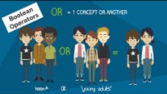
Tips for Effective Search Strategies
WATCH HERE
Learn how you can use BOOLEAN OPERATORS, QUOTATION MARKS AND ASTERIX/STAR SYMBOL to boost your search

Slide 17
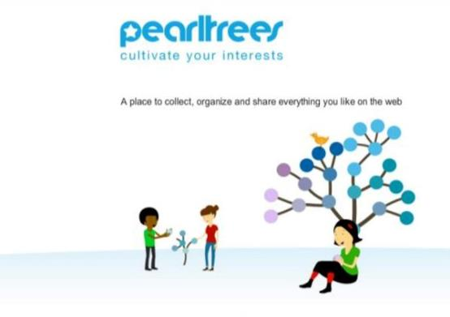
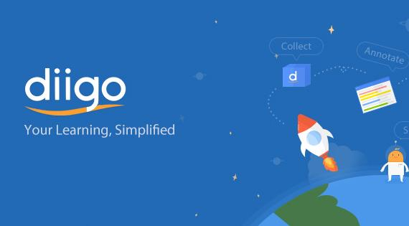

Digital tools x 3 to help you filter and organise data
Pearltrees
refers to itself as "a place for your interests". Functionally the product is a visual and collaborative curation tool
Diigo
is a social website
that allows users to
bookmark and tag Web pages.
Padlet
is a cloud-based software widely used among teachers as a pedagogical tool

Slide 18


TOOL NAME: Pearltrees
- Pearltress is a free, visual and collaborative library that lets you organize web pages, files, photos and notes to retrieve and share them anywhere easily. Pearltrees provides a structure for teachers or students to gather, share, and organize resources.
- Your links, or “pearls”, are connected into “trees” and can be easily embedded onto a website, blog, or Facebook/Twitter account.
Teaching Activities: Preparation, Presentation, Interaction/Assessment, Digital Library
Suitable for Learner Style: Visual, Aural, Print, Practical
Ease of use: Semi-Advanced

Slide 19

Getting Started with Pearltrees
Instructions for Educators
Go to www.pearltrees.com
Sign up using your Email account to begin using Pearltrees
Be sure to watch the video tutorial/templates before starting to create your own lists
Choose a topic you are familiar with and create a quick list on Pearltrees to share with the class!

Slide 20

HOW TO USE PEARLTREES
WATCH THE TUTORIAL HERE

Slide 21
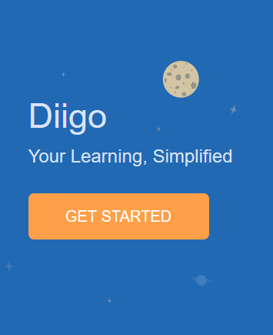
TOOL NAME: Diigo
- Diigo is a social bookmarking website that allows signed-up users to bookmark and tag Web pages. Additionally, it allows users to highlight any part of a webpage and attach sticky notes to specific highlights or to a whole page. These annotations can be kept private, shared with a group within Diigo, or be forwarded to someone else via a special link.
- It can very effectively be used to help students learn how to manage online content using the various Diigo features.
Teaching Activities: Preparation, Presentation, Interaction/Assessment, Digital Library
Suitable for Learner Style: Visual, Print, Practical
Ease of use: Semi-Advanced

Slide 22
Getting Started with Diigo
Visit the Diigo page http://www.diigo.com/education
You can use Diigo with the free basic account (at www.diigo.com), with your personal email
Email Notification – activate your account
Access Teacher Console, where you create and manage student accounts and class groups.
Create A Class Group: Click the "Create A Group for My Class" link to create a group for your class
Create Student Accounts and add to the class group
Manage Class groups / Student Accounts using Teacher Console

Slide 23
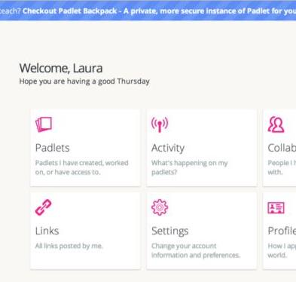
TOOL NAME: Padlet
Padlet is an online virtual “bulletin” board, where students and teachers can collaborate, reflect, share links and pictures, in a secure location. Padlet allows users to create a hidden wall with a custom URL.
Padlet creators can also moderate posts, remove posts, and manage their board 24/7.
Teaching Activities: Preparation, Presentation, Interaction/Assessment, Digital Library
Suitable for Learner Style: Visual, Print, Practical
Ease of use: Semi-Advanced

Slide 24

How to get started
From a brainstorming board to a live questions bank, there are lots of ways to use Padlet, limited only by your imagination. Even that limit can be overcome by allowing the board to be collaborative so your students can use their imaginations to grow it in new directions.
Click on the picture for tutorial

Slide 25
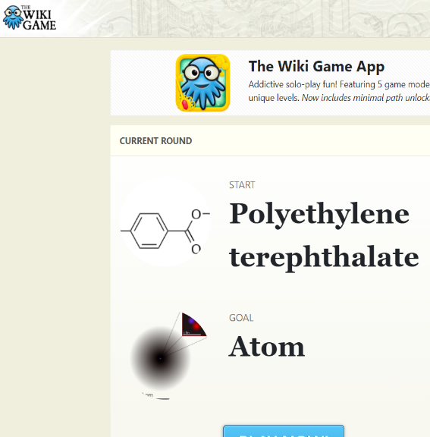

“The Wiki Game”
Explore fun ways to do your research
What? The Wiki Game, also known as the Wikipedia race, is a hypertextual game designed to work specifically with Wikipedia. It requires only a computer, Internet access, a web browser and (optionally) a time-keeping device to play.
Objective? Players (one or more) start on the same randomly selected article and must navigate to another pre-selected target article, solely by clicking links within each article. The goal is to arrive at the target article in the fewest clicks (articles), or the least time. The single-player Wiki Game, known as Wikirace, Wikispeedia involves reducing one's previous time or a number of clicks.
Click to play

Slide 26
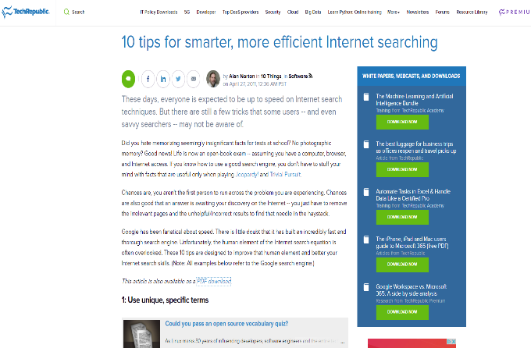


Improve your online research skills
Read and Learn
Overview of the article: These days, everyone is expected to be up to speed on Internet search techniques. But there are still a few tricks that some users -- and even savvy searchers -- may not be aware of. The article (which is available to download upon sign up) outlines 10 effective ways to improve your online researching skills!

Slide 27
EXERCISE: Search Run Game!
Divide your peers into teams of 2 (depending on the size of the class, between 2-3 per team)
Assign each team with a topic to research online (this could be something they are learning in class, or if you want to keep the research topic more fun e.g. celebrity, book, movie etc.)
The first person to find what you have assigned, wins
At the end of the activity the team must share with each other the methods they found effective when searching online e.g. what keywords, advanced search, filters etc
If learners found the research topic easy, repeat the exercise again this time making the research topic more specific/difficult in order to really test learners research abilities

Slide 28
Absorb the next case study and get inspired to explore digital literacy further

Slide 29



CASE STUDY: ReDI School Copenhagen
Click to watch

Slide 30
DIGITAL WOMEN PROGRAM
Copenhagen
ReDI School is for you if you are:
A woman with an ethnic minority background or limited access to education and network
Interested in improving your digital skills
Looking to meet new people
Looking to establish a professional network
Interested in new job opportunities ​
ReDI School’s Digital Women Program in Copenhagen aims to empower ethnic minority women by offering them free IT courses and other activities.
The courses support the students in developing their digital skills. The aim is to accelerate their integration in Denmark and provide them with new opportunities, both in their everyday life and in the job market.
The courses also support the students in developing their communication and collaboration skills and help them expand their personal and professional network - all to create new opportunities.
They offer three courses: Digital Literacy, Introduction to Coding and User Experience.

Slide 31

Did you know?
The Broadband Commission’s Working Group on “Digital Gender Divide” contributes with reviews of existing normative frameworks in order to develop a set of recommendations which address the digital gender divide and foster the equal inclusion of women and girls in broadband access and use, and its Working Group on “Broadband and Gender” analyses the role that ICTs and the Internet can play in advancing gender equality agendas, including equal access to new technologies by women and girls.
https://www.broadbandcommission.org/working-groups/digital-gender-divide-2017/

Slide 32

2. Evaluating data, information and digital content

Slide 33
Important definitions
Digital content is any content that exists in the form of digital data. Also known as digital media, digital content is stored on digital or analogue storage in specific formats.
Information is processed, organised and structured data. It provides context for data and enables decision making. For example, a single customer’s sale at a restaurant is data – this becomes information when the business is able to identify the most popular or least popular dish.
Evaluating data, information and digital content is to ensure it's meaningful, looking critically at information to determine its relevance, suitability and reliability.

Slide 34
How do I know if my sources are credible/reliable?
With so much content available it is important to be able to judge what information is accurate and reliable, and what is not. Here are useful tips to evaluate content:
Check the URL/website address
Take a closer look
Look beyond the headline
Remember, the camera can lie
Just because information goes viral does not mean that it is accurate
Check other sources
Check the facts
Ask the experts

Slide 35

CREDIBILITY IS CONTEXTUAL
Click to watch

Slide 36
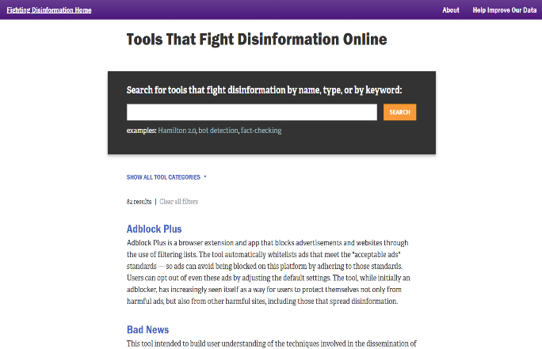

Read and Learn
Overview of the article: This web page acts as a toolbox with links and descriptions to 82 tools/platforms that aim to prevent disinformation, fake news, untrustworthy social media accounts and much more.

Slide 37
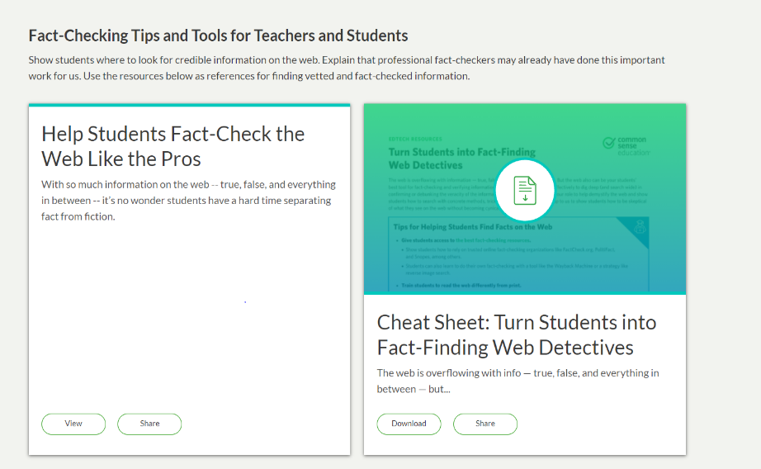
Read, learn and utilise!
What? Can the web be your best tool in the fight against falsehood?
From viral memes to so-called "fake news," the web is overflowing with information, true, false, and everything in between. For many internet users, this makes the web a challenging place to find credible and reliable sources. So what's the best way to help you use the web? Here you'll find tips, resources, and practical advice on helping students find credible information online.
Click to read and try out the lessons!

Slide 38
EXERCISE: True or False?
Research the latest/trending news stories circulating. Select 2 fake news stories and 2 real stories from the media.
Share with peer students (either digitally or not) the selected stories.
Ask them to evaluate the information you have shared with them. Allow students to vote true or false (you can use a digital polling tool for this if you wish) on the 4 pieces of information.
Now, assign students 10 minutes to research the story.
Re-poll to see how effective your research abilities are in detecting between real and fake news.

Slide 39

3. Managing data, information and digital content

Slide 40
Important definitions
Information Management is an organizational program that manages the people, processes and technology that provide control over the structure, processing, delivery and usage of information required for management and business intelligence purposes.
Data Management is a subset of Information Management. It comprises all disciplines related to managing data as a valuable, organizational resource. Specifically, it’s the process of creating, obtaining, transforming, sharing, protecting, documenting and preserving data.

Slide 41

Read and learn
Data management introduction!
This article provides a great introduction for beginners into:
What data is,
How it is stored,
The types of data,
Data management and use
Data professionals
https://searchdatamanagement.techtarget.com/definition/data

Slide 42
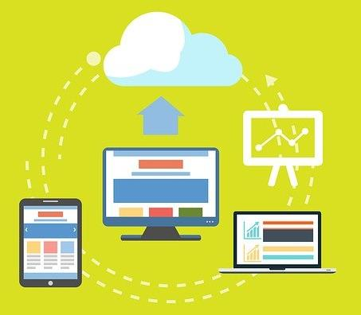
Organising and storing data
Once you create, gather, or start manipulating data and files, they can quickly become disorganised. To save time and prevent errors later, you and your colleagues should decide how you will name and structure files and folders. Including documentation (or 'metadata') will allow you to add context to your data so that you and others can understand it in the short, medium, and long term.
Below you can find some guidance on:
Naming and Organising Files
Documentation and Metadata
Managing References
Organising E-mail

Slide 43
Naming and Organizing Files
Choosing a logical and consistent way to name and organise your files allows you and others to easily locate and use them. Ideally, the best time to think about how to name and structure the documents and directories you create is at the start of a project.
Organising your files carefully will save you time and frustration by helping you and your colleagues find what you need when you need it.
How should I organise my files?
Use folders | Be consistent | Name folders appropriately
Backup | Structure folders hierarchically | Adhere to existing procedures
Review records | Separate ongoing and completed work | Try to keep your ‘My Documents’ folder for files you are actively working on

Slide 44



Documentation and Metadata
When and how do I include documentation/ metadata?
The term 'documentation' encompasses all the information necessary to interpret, understand and use a given dataset or set of documents.
It is a good practice to begin to document your data at the very beginning of your research project and continue to add information as the project progresses. Include procedures for documentation in your data planning.

Slide 45

What Is Metadata and How Do I Document My Data?
SOURCE: CESSDA TRAINING https://www.youtube.com/channel/UCjjXLipqgmrebx6yqcVqaWg

Slide 46
Managing References
Projects can last for months or years, and it is easy to lose track of which piece of information came from which source. Your future self may not remember everything that seems obvious in the present, so it is important to take clear notes about your sources.
Reference management software helps you keep track of your citations as you work, and partially automates the process of constructing bibliographies when it is time to publish.
Your departmental librarian will be able to help you pick the right format for references and will probably know about some useful search and management tools that you have not used before. Feel free to ask him/her for advice.
Additionally, your college librarian is also a very good resource and is there to help.
SOURCE: https://www.data.cam.ac.uk/data-management-guide/organising-your-data

Slide 47


Organising e-mail
If your emails have gotten out of control, there are several immediate steps you can take to control the problem!
Archive your old emails
Go through your remaining inbox email by email
If you have hundreds of emails hanging around from more than a month ago, move them into a new folder called something like "Archive".
If an email is useless, delete it.

Slide 48



Organising and storing data TOOLS
Dropbox
is a top-rated file sharing platform, with a free version.
Google Drive
is one of the Dropbox alternatives that you’ve probably heard of. Google offers free file storage and sharing cloud to its 1.5 billion Gmail users.
OneDrive
is another good alternative and file storage platform offered by Microsoft.

Slide 49
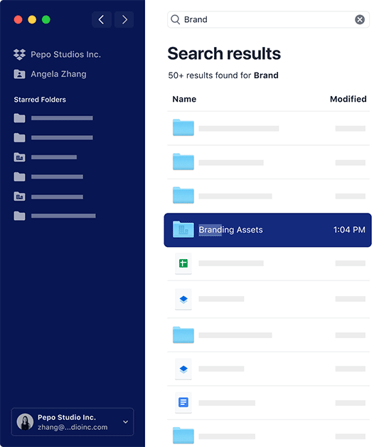
TOOL NAME: Dropbox
Dropbox
offers free and paid file storage services. The platform currently has over 500 million users, of which only 13.2 million are paying users.
For the non-paying majority using Dropbox’s Basic (free) version, one of the biggest challenges, ironically, is space. Dropbox Basic offers a measly 2GB of free storage. It also caps the number of devices you can sync to three and does not offer full-text search, shared link controls, or viewer history.

Slide 50
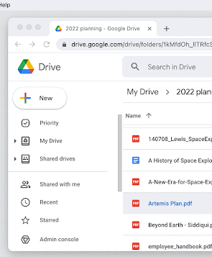
TOOL NAME: Google Drive
Google Drive
offers free file storage and sharing cloud to its 1.5 billion Gmail users. So, if you already have a Gmail or Google account, this is the obvious cloud storage option to go with. Some of the platform’s highlights include:
- Connect with 100+ Drive Apps, including Slack, Airtable, Freshdesk, and Zipbooks.
- Save files directly to the cloud from email using the “Save to GoogleDrive” icon in Gmail.
- Use the “work offline” mode to work on files while off the Internet. The files get automatically synced to the cloud as soon as you go online.

Slide 51

TOOL NAME: One Drive
One Drive
is a file storage platform offered by Microsoft. Just like Gmail users have access to Google Drive, OneDrive comes built-in with Windows 10. Some of the platform’s highlights include:
Auto-sync files, any files you save on your computer will get automatically uploaded to the cloud.
Search files stored on the cloud via your browser.
Control access to your files, share them with users via a link and control what they can do with the files.
Automatically upload photos and videos from connected devices.

Slide 52
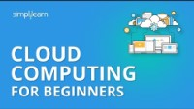
Watch this video
Below topics are explained in this Cloud Computing Tutorial:
1. Why cloud computing?
2. What is cloud computing?
3. Types of cloud computing?
4. Cloud providers
5. The lifecycle of a cloud computing solution
6. Cloud computing with AWS
7. Demo - AWS EC2 and AWS S3
Click to play and listen

Slide 53

4. Overcoming language and cultural barriers to information and data literacy

Slide 54
Important definitions
A language barrier is a figurative phrase used primarily to refer to linguistic barriers to communication, i.e., the difficulties in communication experienced by people or groups originally speaking different languages, or even dialects in some cases.
A cultural barrier is an issue arising from a misunderstanding of meaning, caused by cultural differences between sender and receiver.

Slide 55

„
“If you talk to a man in a language he understands, that goes to his head. If you talk to him in his language, that goes to his heart,” former South African President Nelson Mandela said.
„

Slide 56
How does language affect your experience of the internet?
For those who cannot speak or understand English, much of the internet is out of reach.
Native English speakers – around 5% of the global population – probably don’t notice a difference between real life and online life, since more than half of the web is in their language.

Slide 57
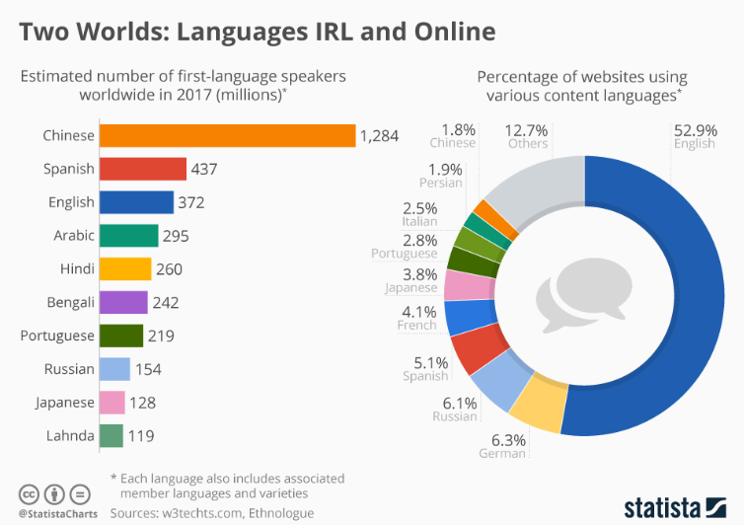
Diversity of browsing: language needs

Slide 58


Having a migrant background might mean you are multilingual or prefer browsing in a certain language. Embracing this and knowing how to navigate through technology to get the best results in different languages, can help you source great results.
By default, the Internet browser language is regional; wherever you are in the world, your browser displays the language that is predominantly spoken there. To change the default language displayed in an Internet browser, follow the instructions.
Click to read

Slide 59
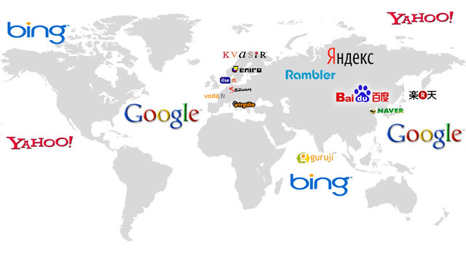
International Search Engines You Should Optimize For
Different search engines are used in different countries, plus for the same search engines results differ depending on a location. We find it important that teachers and learners become aware of this effect. It is important for the adaptation, expectations when doing the research and it’s something to be addressed.
Search engines typically filter the results they give you as a way of making the results more useful. They use information from your computer such as your browser and IP address, as well as any account information they have from you.

Slide 60

Using more than one search engine can help you get better information. Alternatively, some engines, including Google, let you turn off the personalization and conduct unfiltered searches.
List of search engines that are important to you
Google
Bing
Yahoo
Baidu
Qihoo360
Yandex
Naver
DuckDuckGo
Ask.com
AOL

Slide 61



List of search engines
Google is one of the most obvious international search engines, but when it comes to producing content for other countries, there are still some important steps to take into account.
Bing is the second-most popular search engine in the US. On a global scale it has also earned a position as the second-largest of the international search engines.
Yahoo is the third largest search engine in the US, commanding about 12% of searches, resulting in millions of opportunities to engage customers.

Slide 62



List of search engines
The #1 search engine in China, Baidu, is the third most popular search engine worldwide, receiving roughly 60% of domestic search traffic.
Yandex remains the dominant international search engine in Russia and parts of surrounding countries, although Google continues to try and secure this position for itself.
DuckDuckGo is a unique international search engine because it does not store any user information. It shows the same results to all users regardless of search history or location

Slide 63

TOP TIP! – If you would like to help the environment while browsing – use ECOSIA
The search engine that plants trees.
The search engine Ecosia is trying to slow climate change by funnelling profits into organizations that plant trees in deforested areas.
How it works ... You search the web with Ecosia. Ads Search ads generate income for Ecosia. Ecosia uses this income to plant trees.
www.ecosia.org

Slide 64
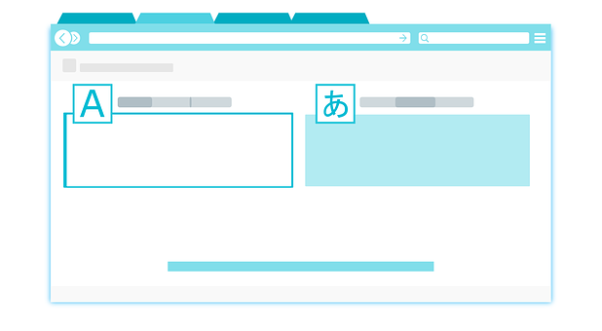
Online translation tools recommended by translators
The translation process can often be somewhat tedious—sometimes covering a multitude of topics, requiring extensive research and contextual knowledge. Fortunately, the digital revolution triggered the creation of tools, software and resources that helps ease the burden of translation and improve efficiency, consistency and quality. Below is a list of translation tools that are recommended by translators:
Linguee
Reverso
Google Translate including the plugin
Captions on Youtube

Slide 65
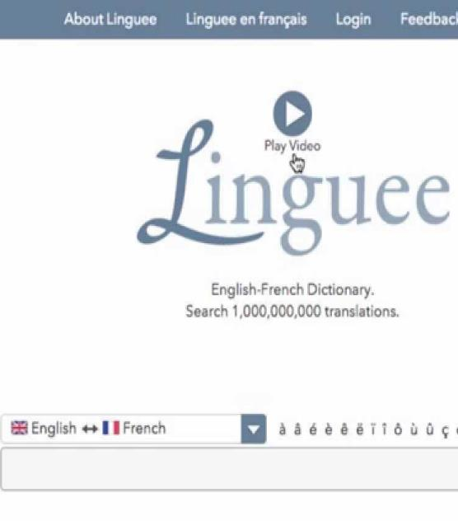
TOOL NAME: Linguee
A crowd favourite, this unique translation tool combines a dictionary with a search engine, so you can search for bilingual texts, words and expressions in different languages to check meanings and contextual translations. Linguee also searches the web for relevant translated documents and shows you how a word is being translated throughout the internet. It is often used in conjunction with Google Images to help translators and language learners alike.

Slide 66
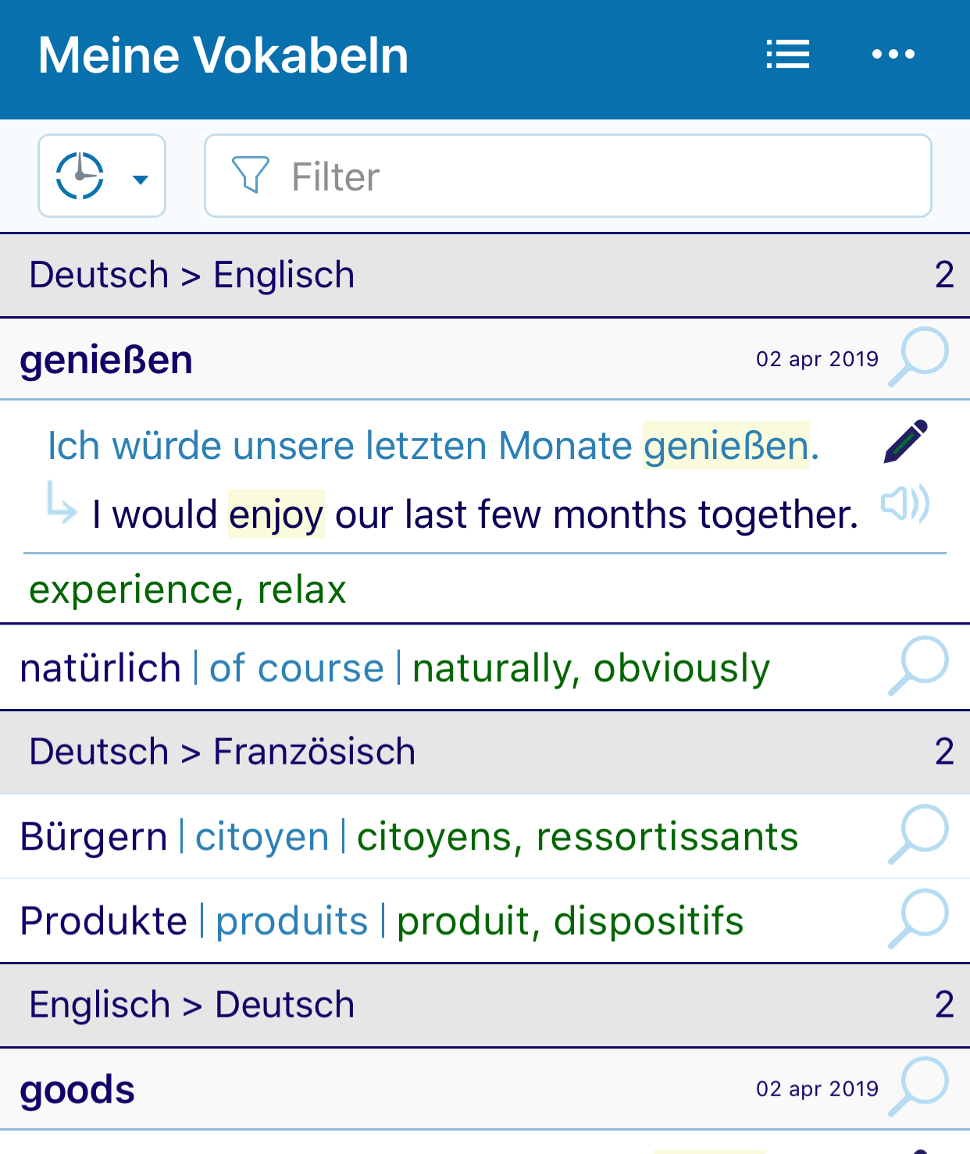
TOOL NAME: Reverso
Reverso is a company specialized in AI-based language tools translation aids and language services. These include online translation based on NMT (Neural Machine Translation), contextual dictionaries, online bilingual concordances, grammar and spell checking and conjugation tools.

Slide 67
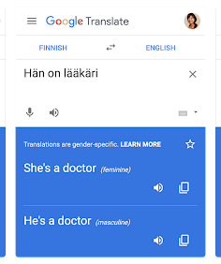
TOOL NAME: Google Translate
Google Translate is a multilingual neural machine translation service developed by Google, to translate text, documents and websites from one language into another. It offers a website interface, a mobile app for Android and iOS

Slide 68
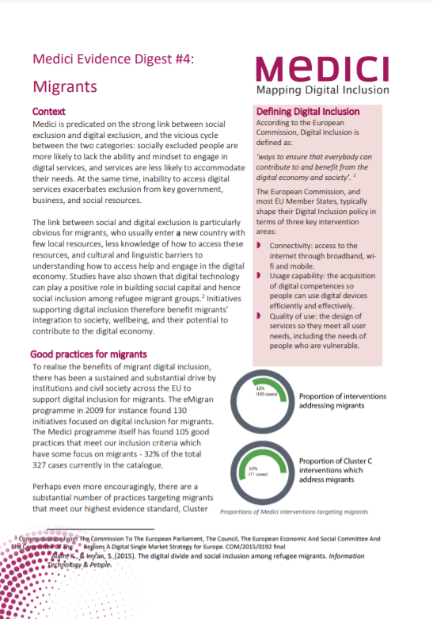
Read and learn
MEDICI (Mapping Digital Inclusion) article
This article provides a great insight into explaining the digital gap of migrants. It provides good practice examples of how to engage migrants in digital skills training.

Slide 69

Women In Language – join an online community
Lately, women have had more opportunities to join online networking communities.
To overcome any language barriers, we recommend you look for and join networking opportunities with your peer female students, women in business, or women in your community. This will fast forward your language progression.
Here is one event and community you can join: Women In Language
You love languages?
You want to learn more about how to study, how to work, and how to live with languages? And you love nothing more than to connect with others and discuss your passion for languages with experts from all around the world?
Introducing Women in Language: https://womeninlanguage.com/

Slide 70
Conclusions to this module
Social skills, soft skills, communication skills are at the core of us as social beings, as individuals, groups as students.
Digital content is the basic holder of information today and the fastest and most efficient way to communicate an idea, finding, information is to create and share digital content
It has long been thought that a student-centred project that ends with students creating a piece of material engages the student because of the sense of ownership of the final piece. This has not changed today; yet, in a world where students are surrounded by digital content and rich media, it may be more engaging and motivating for them to create projects that are digital and can compete with the digital world they live in.

Slide 71
Main conclusions to this module:
Planning your online search, and using available tools to organise it, will bring better results for your research
Not all search results are credible. Using the tools suggested here, we can make sure we know how to evaluate and choose credible results
Managing data, content and information, rather sooner than later, will mean you will become more efficient and save time in the long run
Language barriers and differences in the online world are real, getting to know different search providers and tools, helps you overcome barriers and multiply your results

Slide 72
In the next module learn how to
Communicate and collaborate digitally, specifically you will learn about:
Interacting through digital technologies
Sharing through digital technologies
Engaging in citizenship through digital technologies
Collaborating through digital technologies
Netiquette
Managing digital identity

Slide 73
Thank you and congratulations on finishing Module 1!
www.includeher.eu

